Slide 1
Richmond
Community of Care
Open Board Forum
June 4, 2019

Slide 2
Welcome and introductions
Vivian Eliopoulos, vice-president, Vancouver Coastal Health Richmond and Vancouver acute
Laura Case, vice president, Vancouver Coastal Health Richmond and Vancouver community
Dr. Alexandros Alexiadis, co-senior medical director and clinical medical director of Palliative Care, Vancouver Coastal Health-Richmond
Dr. Nancy Austin, co-senior medical director and department head of Emergency, Vancouver Coastal Health-Richmond

Slide 3
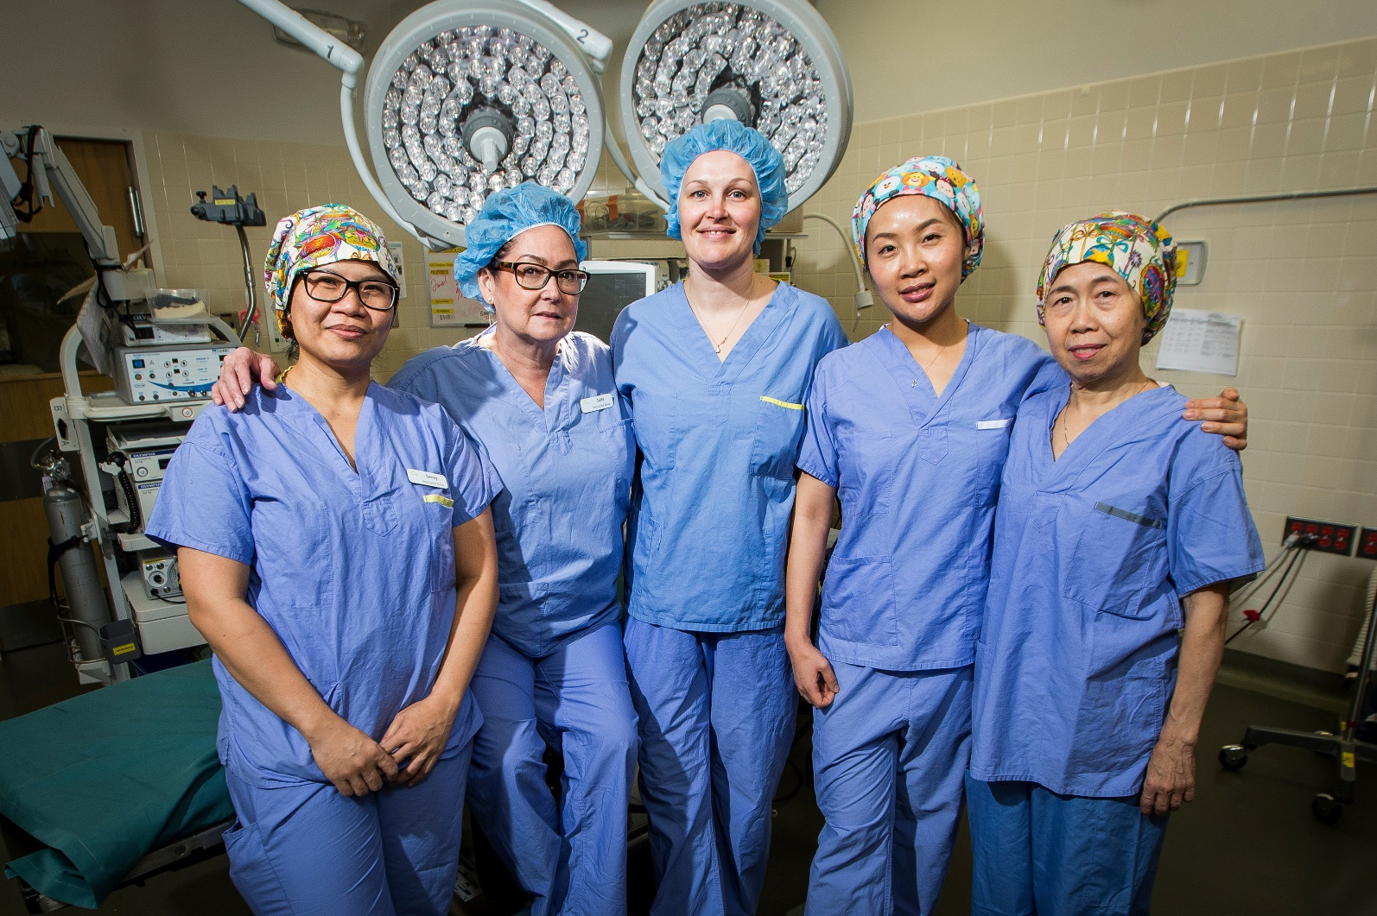
Surgery

Slide 4
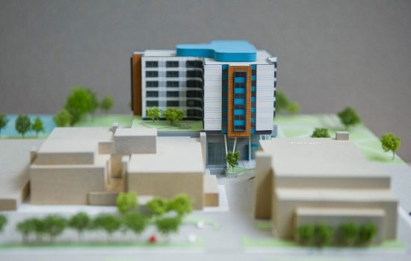
Acute Care Tower

Slide 5
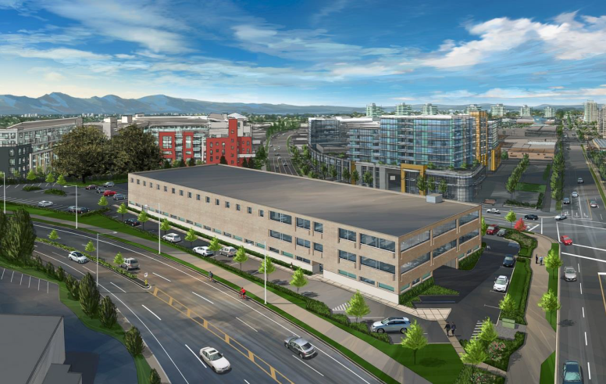
Community Health Access Centre (CHAC)
Notes:
[LAURA] As many of you know, the dream of creating a Community Health Access Centre (CHAC)​ here in Richmond has been envisioned for over a decade—its need, well-documented as our community continues to see the fastest growing senior's population in the province.
Since we received approval from the VCH Senior Executive Team is 2017, our team has been hard at work engaging stakeholders around the organization reviewing program and services, developing clinical service plans, functional programming, and envisioning the future state for the delivery of all our community-based programs. Last month, the Ministry of Health approved the business plan for Richmond's first CHAC, which will be located at Alderbridge Way and XX
Over the next few months, we will begin some important activities that will move us forward in our estimated goal to launch our new centre early next year. This includes decanting of the third floor of our space on Alderbridge, putting out an RFP for construction, and identifying a contractor.
The Richmond Hospital Foundation has, of course, been generous in their funding of this project, confirming $800,000 in donations to help enable CHAC’s completion.
Add in which services: Hub for home health staff, centre for all our HS centre, as well as our staff that working with the PCN networking

Slide 6
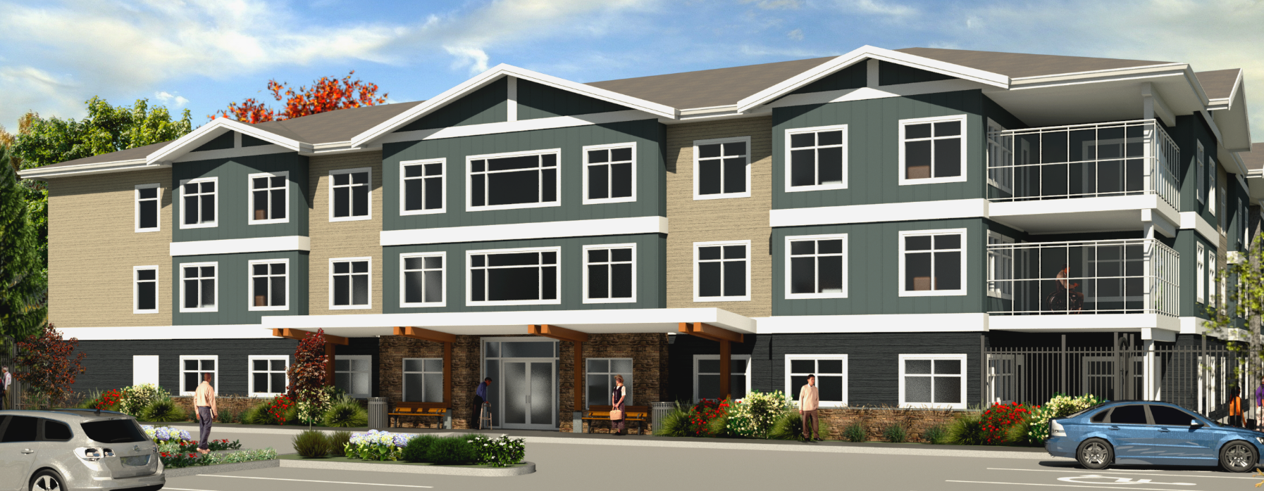
Additional Respite and
Long term care
Notes:
[LAURA]
There are also a few exciting developments underway in Long Term Care.
Richmond has received funding to expand and centralize overnight respite care beds as part of a regional effort to improve caregiver support.
Respite care is someone wh owants to stay at home, not LT care, can fo short term in respite so family can get a break, place where ppl can get a bit stronger so they can go back home. Families have peace of mind knowing loved one is being taken care of. What does this mean for the population of Richmond. Respite, what it is, and what it means, and when it will be open
This funding will increase the number of respite beds from five to 12 and offer respite residents access to services in their community including social and leisure programming seven days a week during their stay. To facilitate this change, our respite beds currently located at various sites within and outside of Richmond (Minoru, Rosewood, Suncrest) will be brought together at one site at Richmond Lion’s Manor – Bridgeport (RLMB). As Richmond's newest, and most secure facility, RLMB offers an inviting physical environment with comfortable indoor and outdoor spaces and private respite rooms. Current respite spaces at Minoru, Rosewood Manor, and Suncrest will be converted to Long Term Care beds. We expect all respite beds to be up and running at RLMB by late 2019.
In terms of new developments, our Kaigo/Fraserview redevelopment and expansion project on Williams and Number 4 road is currently waiting on a variance approval from our licensing department to increase the number of double-occupancy rooms in our phase 1 building for 18 months. This would then allow us to combine phase 2 and 3 starting in late September and accelerate our completion date by up to one year. Our new hope is that we can provide our residential care clients access to 194 bed by 2020.
Opening additional LT care beds, additional 194 beds by 2020
The Trellis project at Hamilton Lands is also progressing well. Construction continues, with the pilings and foundation now in place. Our anticipated occupancy date for this project is mid-2020, providing 135 beds residential care beds. – add cross-streets
As you can see, lots of new great options LT care beds in the community, but using some for respite so ppl have short term options for them and families

Slide 7

Investing in home health care
Notes:
[LAURA]
We want to receive car where possible in our home, where we’re most comfortable. Would be great for someone to come to my home so I don’t have to go into hospital. Give examples—frail ederly, or someone with pnomea,
-home support -3 million
-professional staff in your doctors office
-physio to provive rehab in the home
-teams that can helo with your tranisiton from acute
-pcn – additional staff working with your family doc 25 million
While we continue to invest in new buildings and developments to meet the growing needs of our population here in Richmond, we’re also making significant investments outside of the acute care hospital setting.
As I mentioned, as the seniors population in Richmond continues to grow, so does the need for improved programs and services in the community. Recently, VCH-Richmond has made significant investments with regards to home support and increase respite beds to allow our frail elderly patients to receive the care they need while staying at home. We know that when patients can stay home, they’re able to recover faster and ultimately, live longer, than if they come to the hospital.
One thing we’ve been focusing on is working with our service providers to utilize Enhanced Home Support Funds to support clients and their caregivers to support increased access supports in the community. Daytime respite care, particularly for palliative clients and their caregivers, are being enhanced to support clients and families to have the required to supports for maintaining support for the client and caregivers through this journey. In addition, Enhanced Home Supports are being collectively utilized in partnership with acute care and community care to support clients to live at home while waiting residential care placement.
Working with our service provider partners, we are also increasing overnight care and respite options to help clients remain safely in their homes while whiling placement. In addition, increased home support care is being enhanced to support timely acute care discharges and re-assessed as the client continues to stabilize in their care. Over 1,000 new home support hours were provide in the first period for Richmond CoC, in addition, to our baseline hours.
We’re also working in partnership with the Rosewood long term care facility to formalize a bathing program for clients who could not otherwise access a bath or shower. Our goal is to secure approximately 45 bathing time slots for community clients by mid-June.

Slide 8

Bridging the cultural gap in hospice palliative care

Slide 9
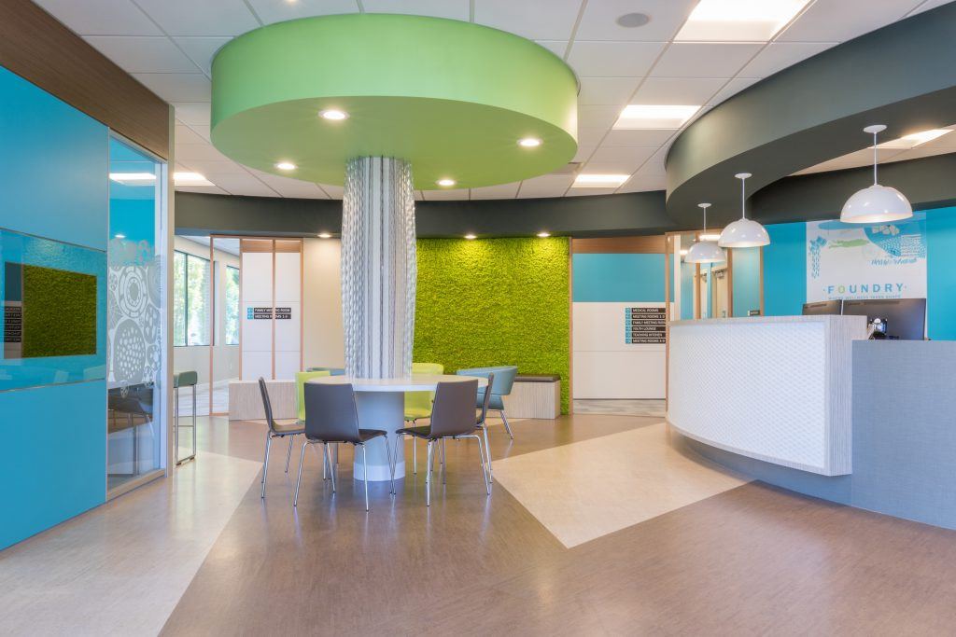
Services for youth
Notes:
[LAURA]
Last year, the Ministry of Health announced it would be providing funding to establish a Foundry centre in Richmond—a health and social service centre for youth aged 12-24—and will join nine other communities around the province in providing a single, approachable, and convenient location for young people to access mental health care, substance use services, primary care, social services, and youth and family peer supports. Low barrier hub for youth to receive the health
Foundry’s goal is to provide safe, non-judgmental care, information and resources, and work to reach young people earlier – before health challenges become problematic. By bringing health and social services together in a single place, we’re able to make it easier for young people to find the care, connection and support they need. Working with our lead agency, Richmond Addictions Services, Foundry Richmond centre will work in collaboration with the entire community and community agencies to help bridge gaps and remove barriers in systems.
We’re currently in the process of securing a location for this new centre. The Richmond Hospital Foundation has been a great partner in this initiative since the beginning and making a 1.5M commitment toward construction and clinical programming start up costs. We look forward to providing more regular updates on this project as we continue to work closely with our internal and external stakeholders and move through our development phases.
What is investment from the ministry? How much from the foundation? If any of you have any spaces please let us know.
I’m going to tell you what foundry is. I’ m a youth. Not confortable going to my family doctor, so this is a place wher ei can get birth control, if I need support, feeling depressed, safe and secure—from physicial to mental health. Beocmea a gathering and connection place.
One liner about engagement session cming up with parents, engagement with communities to ensure services are
Ans shortly Meena will be talking about teen vaping which is a big isse for youth in our community as well.

Slide 10
Thank you and questions
Laura.Case@vch.ca
Vivian.Eliopoulos@vch.ca

