Slide 1


  A note on formatting:
  Each slide comes with key speaking and instructional information for PHNs and teachers in the ‘presenter notes’ part of the powerpoint.
  The font in italics is a script outline- suggestions of words you could say verbally on that slides.
  The “Notes:” unitalicized sections include instructions and tips for the PHN and teacher that are not meant to be read out loud
  Slide background is coloured accordingly: beige = lesson, blue = interactive activity, teal = optional
PILOT: January2024
School Health Promotion:
Physical Health
Setting the Stage:
Sad Story with a Happy Ending
Module #1

Slide 2
PILOT: January 2024
School Health Promotion:
Physical Health
PHN Name, Role
& Fun Fact
Notes:
Introduce yourself as a PHN—Name, Role--Who you are, what you do, why you're here, and a fun fact. Option: add a photo of pet, hobby, or fun fact
Share something with the students that will help build rapport (e.g., mention that you have a cat or dog, or you like to play soccer, or explain why you’re passionate about health promotion).

Slide 3

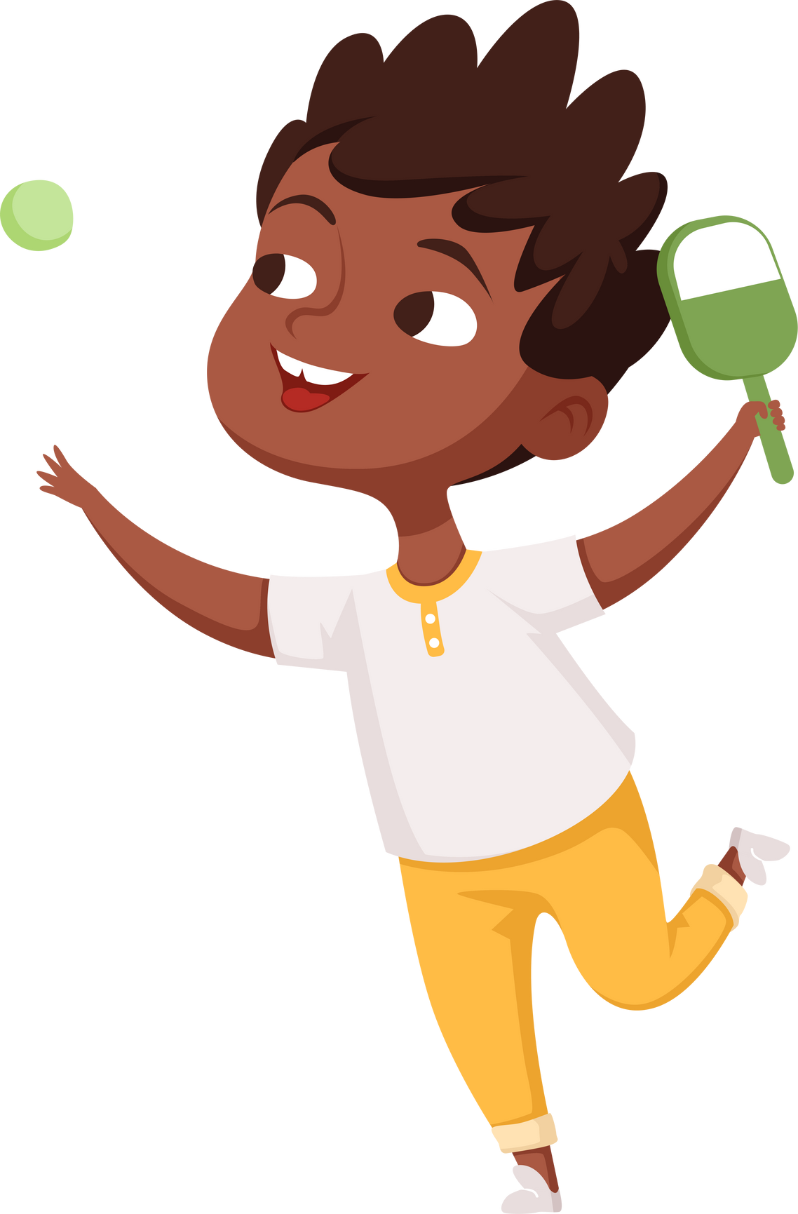
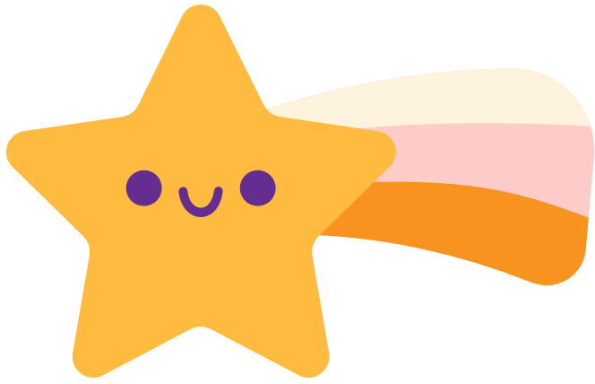
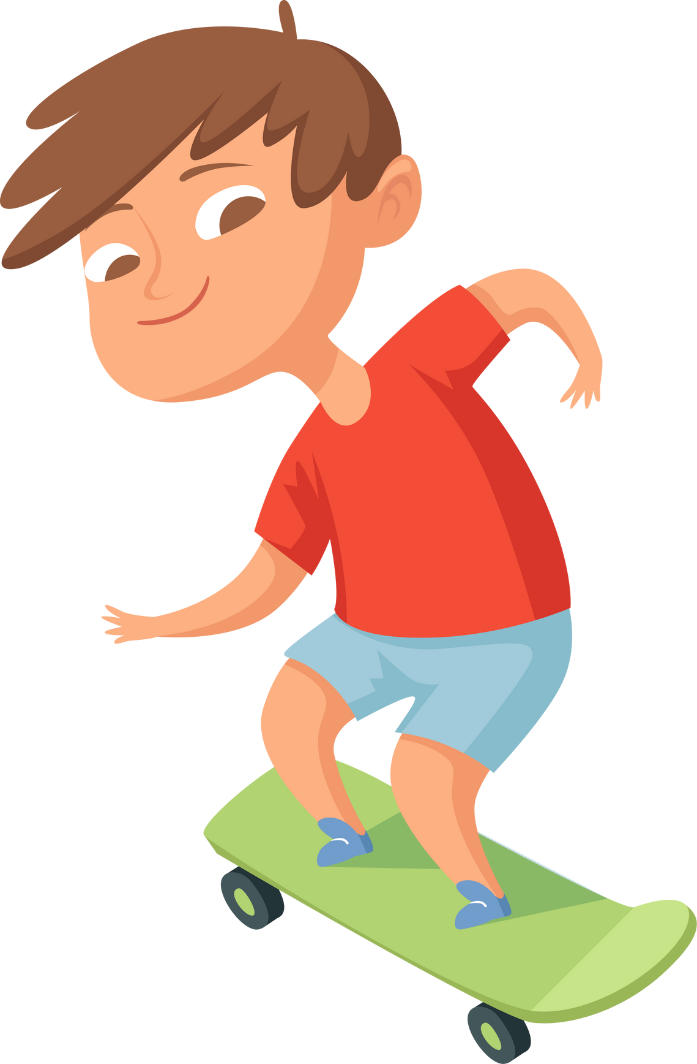
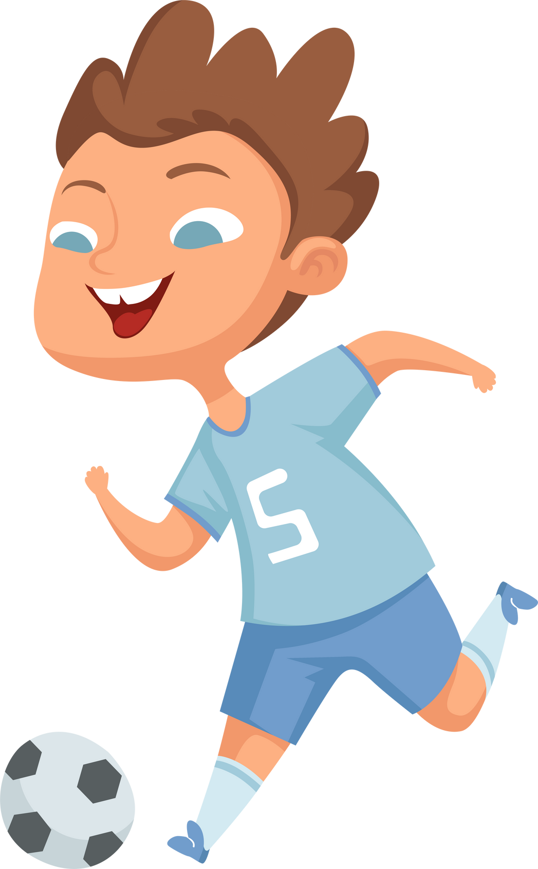
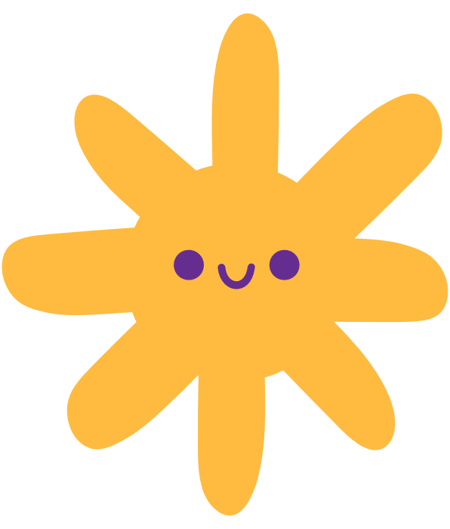

Physical Health
Sad Story with a Happy Ending
PILOT: January 2024
Notes:
Notes:
The goal of this module is to educate students about why movement is important and to motivate them to move anywhere, everywhere, and more often. The Sad Story is designed to explain to students the reasons WHY we need to care about making movement matter. It is also to communicate what the current state is when it comes to the health of children and youth.
It is key to explain the WHY both at as you engage with schools and teachers, and as you bring these learnings into the classroom with students. As you mentor teachers, encourage them to do the same and explain WHY at the beginning of the school year, and as the lessons are brough into the classroom.
The story is designed to grab the attention of the students and to help them understand the importance of moving at every opportunity throughout the day. As students become knowledgeable about the WHY and have fun, they will be more motivated to continue to move, connect with others, and listen to their body throughout the day.

Slide 4
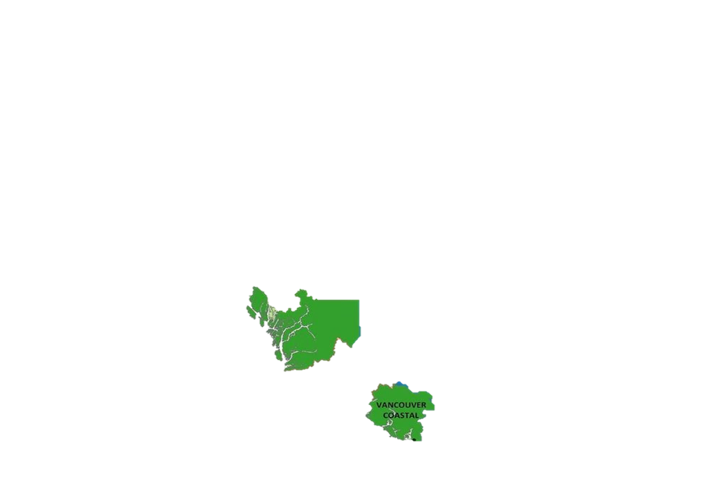
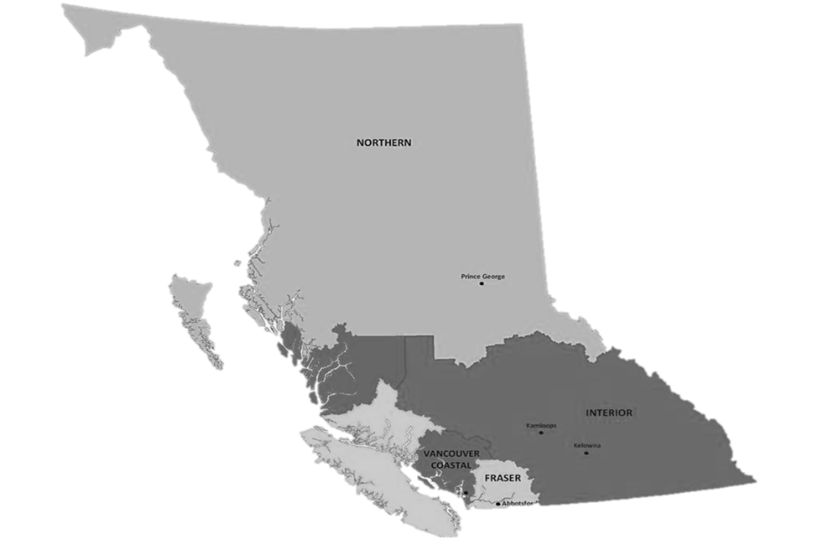
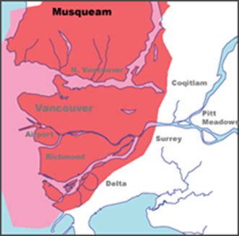
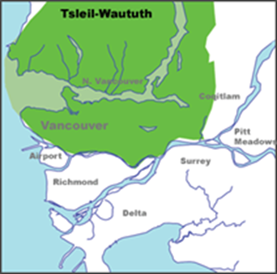
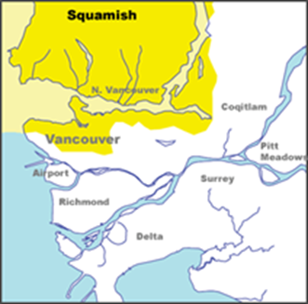
Land Acknowledgment
  We wish to acknowledge that the land on which we gather is the traditional and unceded territory of the Coast Salish Peoples, including the Musqueam, Squamish, and Tsleil-Waututh Nations.
Vancouver Coastal Health is committed to delivering exceptional care to 1.2 million people, including the First Nations, Métis and Inuit, within the traditional territories of the Heiltsuk, Kitasoo-Xai'xais, Lil'wat, Musqueam, N'Quatqua, Nuxalk, Samahquam, shíshálh, Skatin, Squamish, Tla'amin, Tsleil-Waututh, Wuikinuxv, and Xa'xtsa.
Notes:
Notes:
A territory acknowledgement is a relational process. This means that the meaning and purpose changes across time and space, and with the specific context in which it takes place. Take some time to learn about the territory on which the school you are in is situated and connect the honouring to the context of the classroom and module concepts. We encourage you to expand upon your territory acknowledgements in a meaningful way.

Slide 5


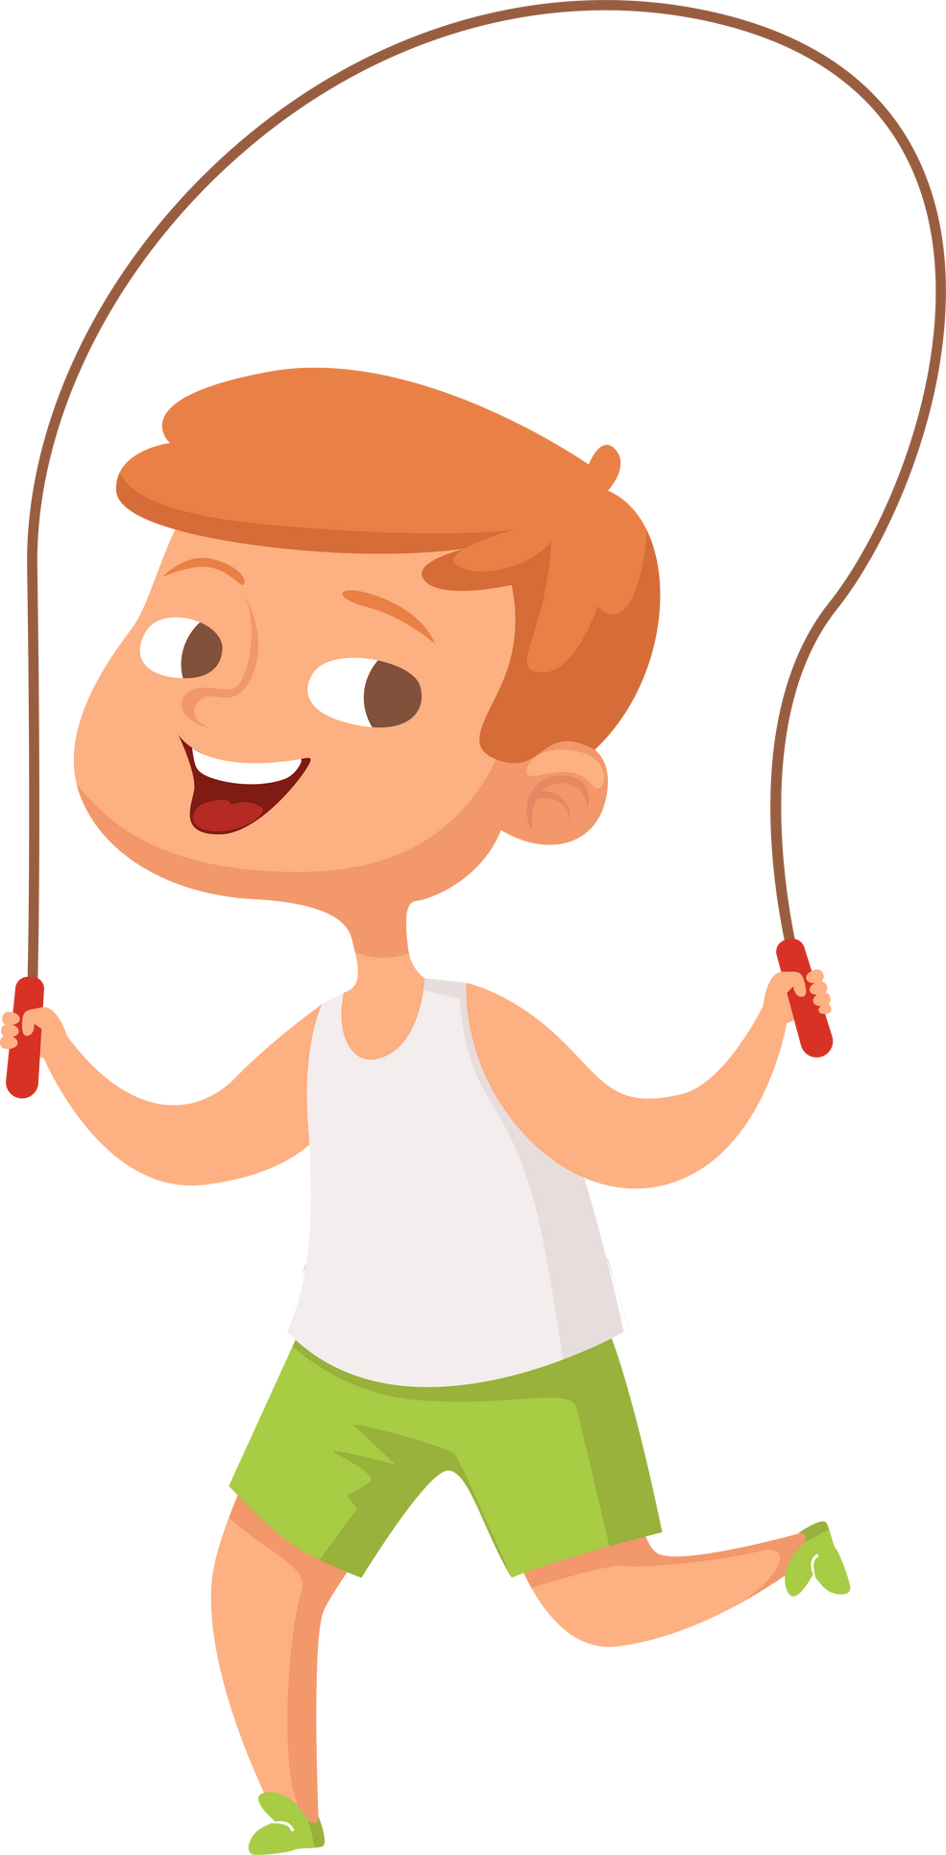
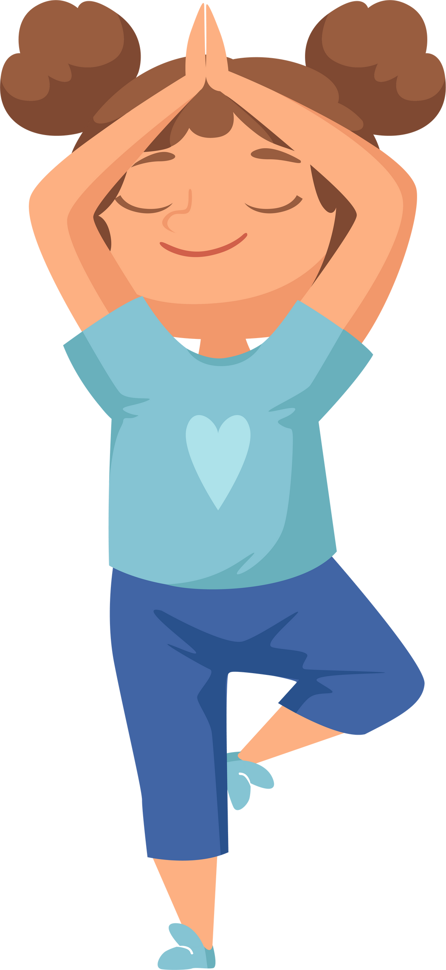
Check in:
How do you feel right now?
What is your current mood?
Notes:
Ask the class: How are you feeling right now?
Did you know we are going to learn about why and how movement makes you happy and healthy?
Notes:
When asking the class how they’re feeling, connect it to physical, emotional and social state
If the class seems distracted, they may need a movement break: you can name specific feelings (e.g. hungry, excited, tired, etc.) and invite students to stand up if they are feeling what you describe..
Another movement break is coming up on the next slide too!
Pay attention to students that seem to be having a hard time and follow up with the student or teacher after the class as appropriate

Slide 6

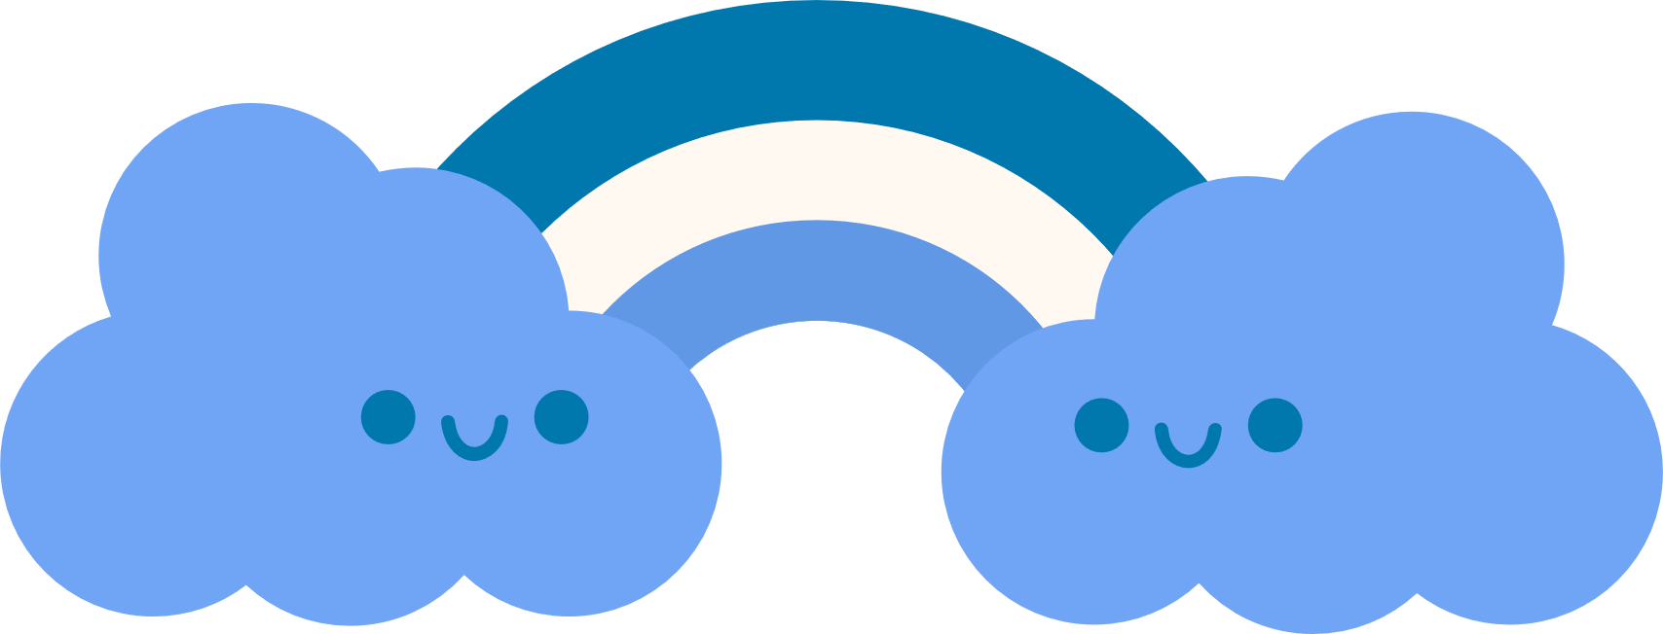
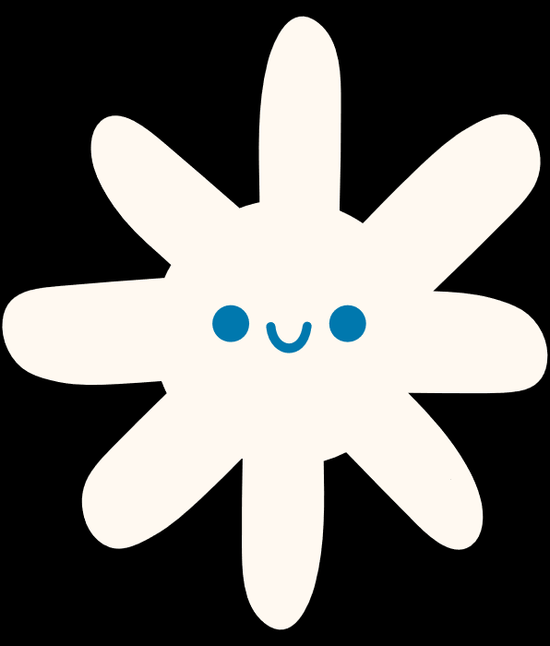

Movement Break!
Show me these skills:
Hop
Jump
Lateral jump
Overhand Throw
Soccer Kick
Backwards Balance Walk - Heel To Toe
Notes:
Movement Break!
Since we’re here to talk about movement, let’s give it a try!
Can you show me what a hop is?
.. what about a jump? … a lateral jump?
What about an overhand throw? What does that look like?
And who has kicked a soccer ball before? What does a soccer kick look like?
Finally, let’s try the backward balance walk!
Notes:
This movement activity gives a chance for students to get some of that pent up energy out so they are engaged and ready to listen.
It also provides an opportunity for you to assess where the class is in their physical literacy skills. Are there any students that need a bit more support?
Demonstrate these skills for 30-60 seconds each and invite the students to join you.
Few things to note regarding these fundamental movement skills:
Hop- one foot,
Jump - two feet,
Lateral jump - both feet, side to side,
Soccer kick - use instep, and ensure kick is with opposite foot to opposite leg.
Backwards balance walk – step heel to toe, walking backwards
Depending on what areas you notice need extra support, check out PLAYBuilder: SPA-PL (School Physical Activity and Physical Literacy Initiative) | PLAYBuilder (playbuilderapp.com)

Slide 7

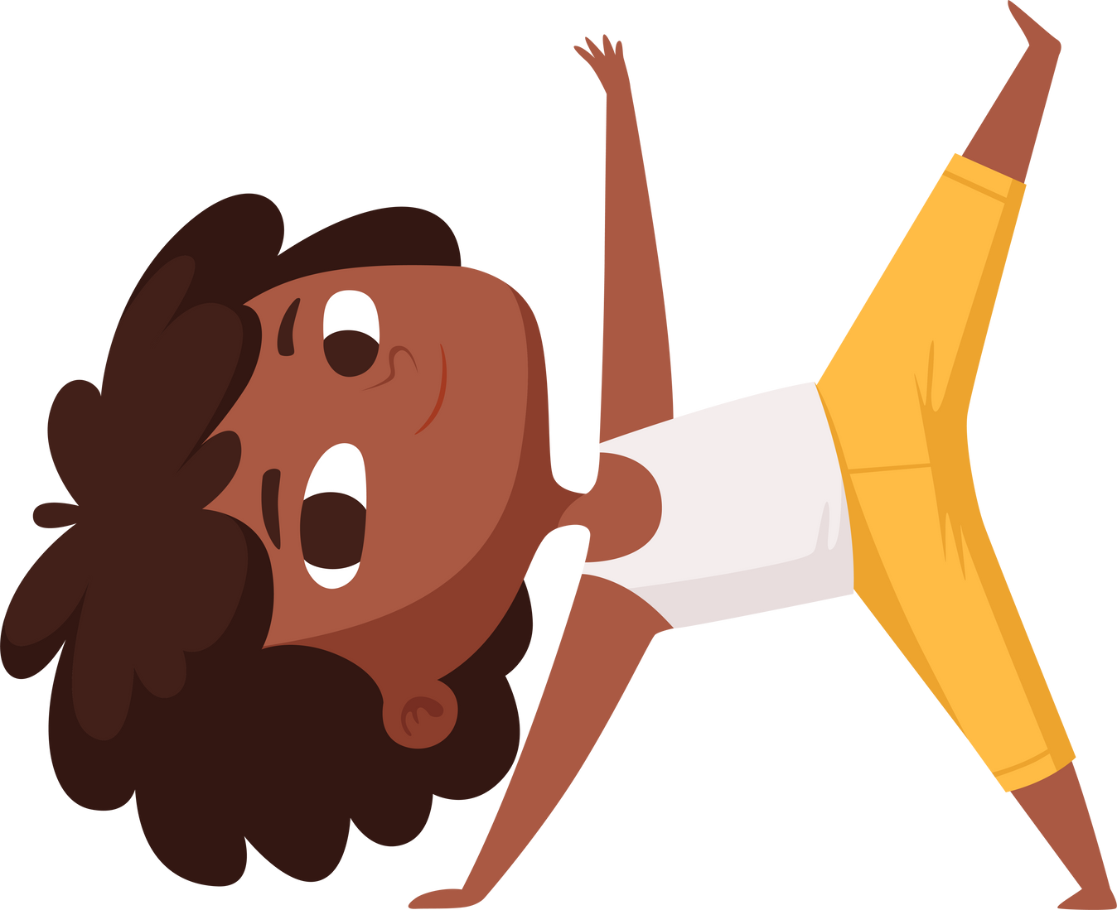

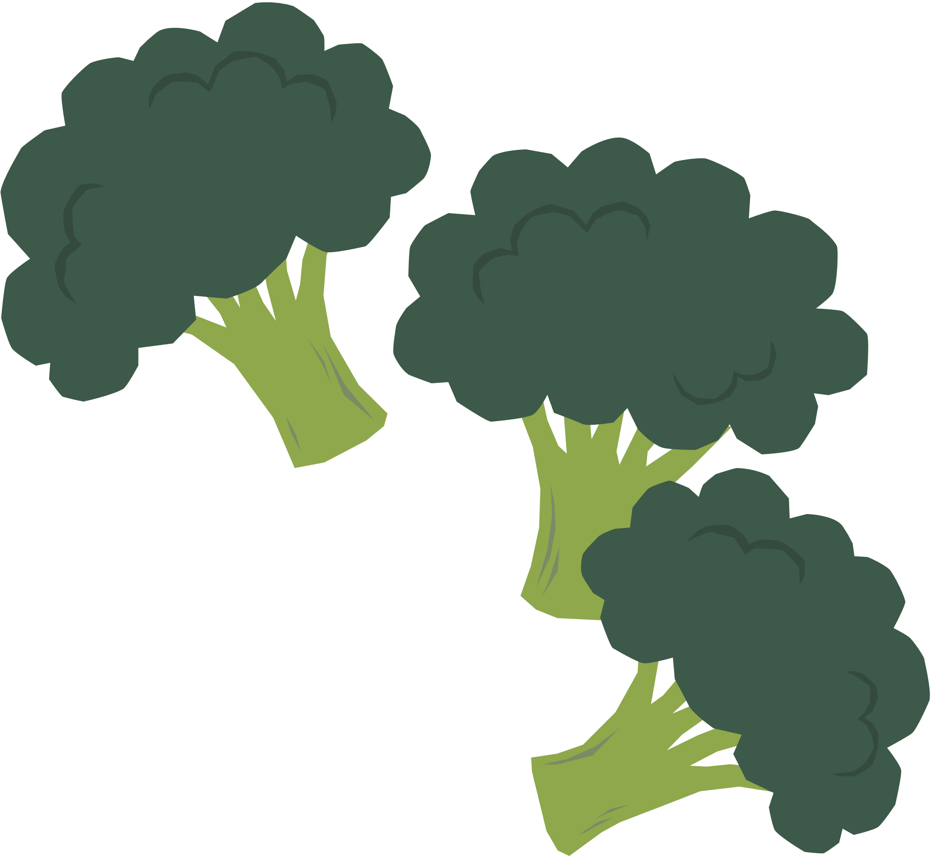

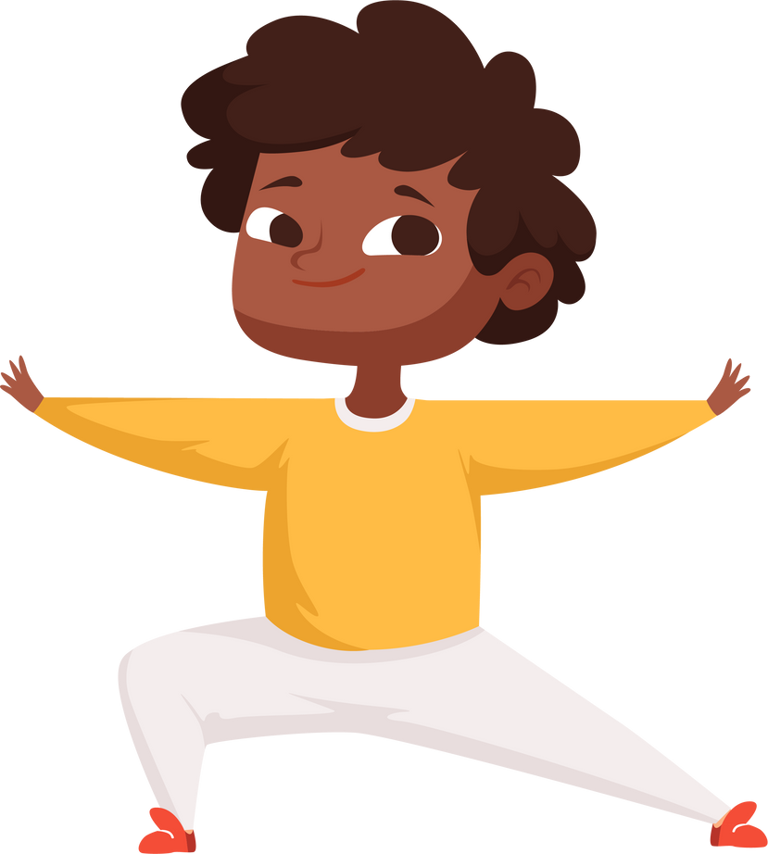
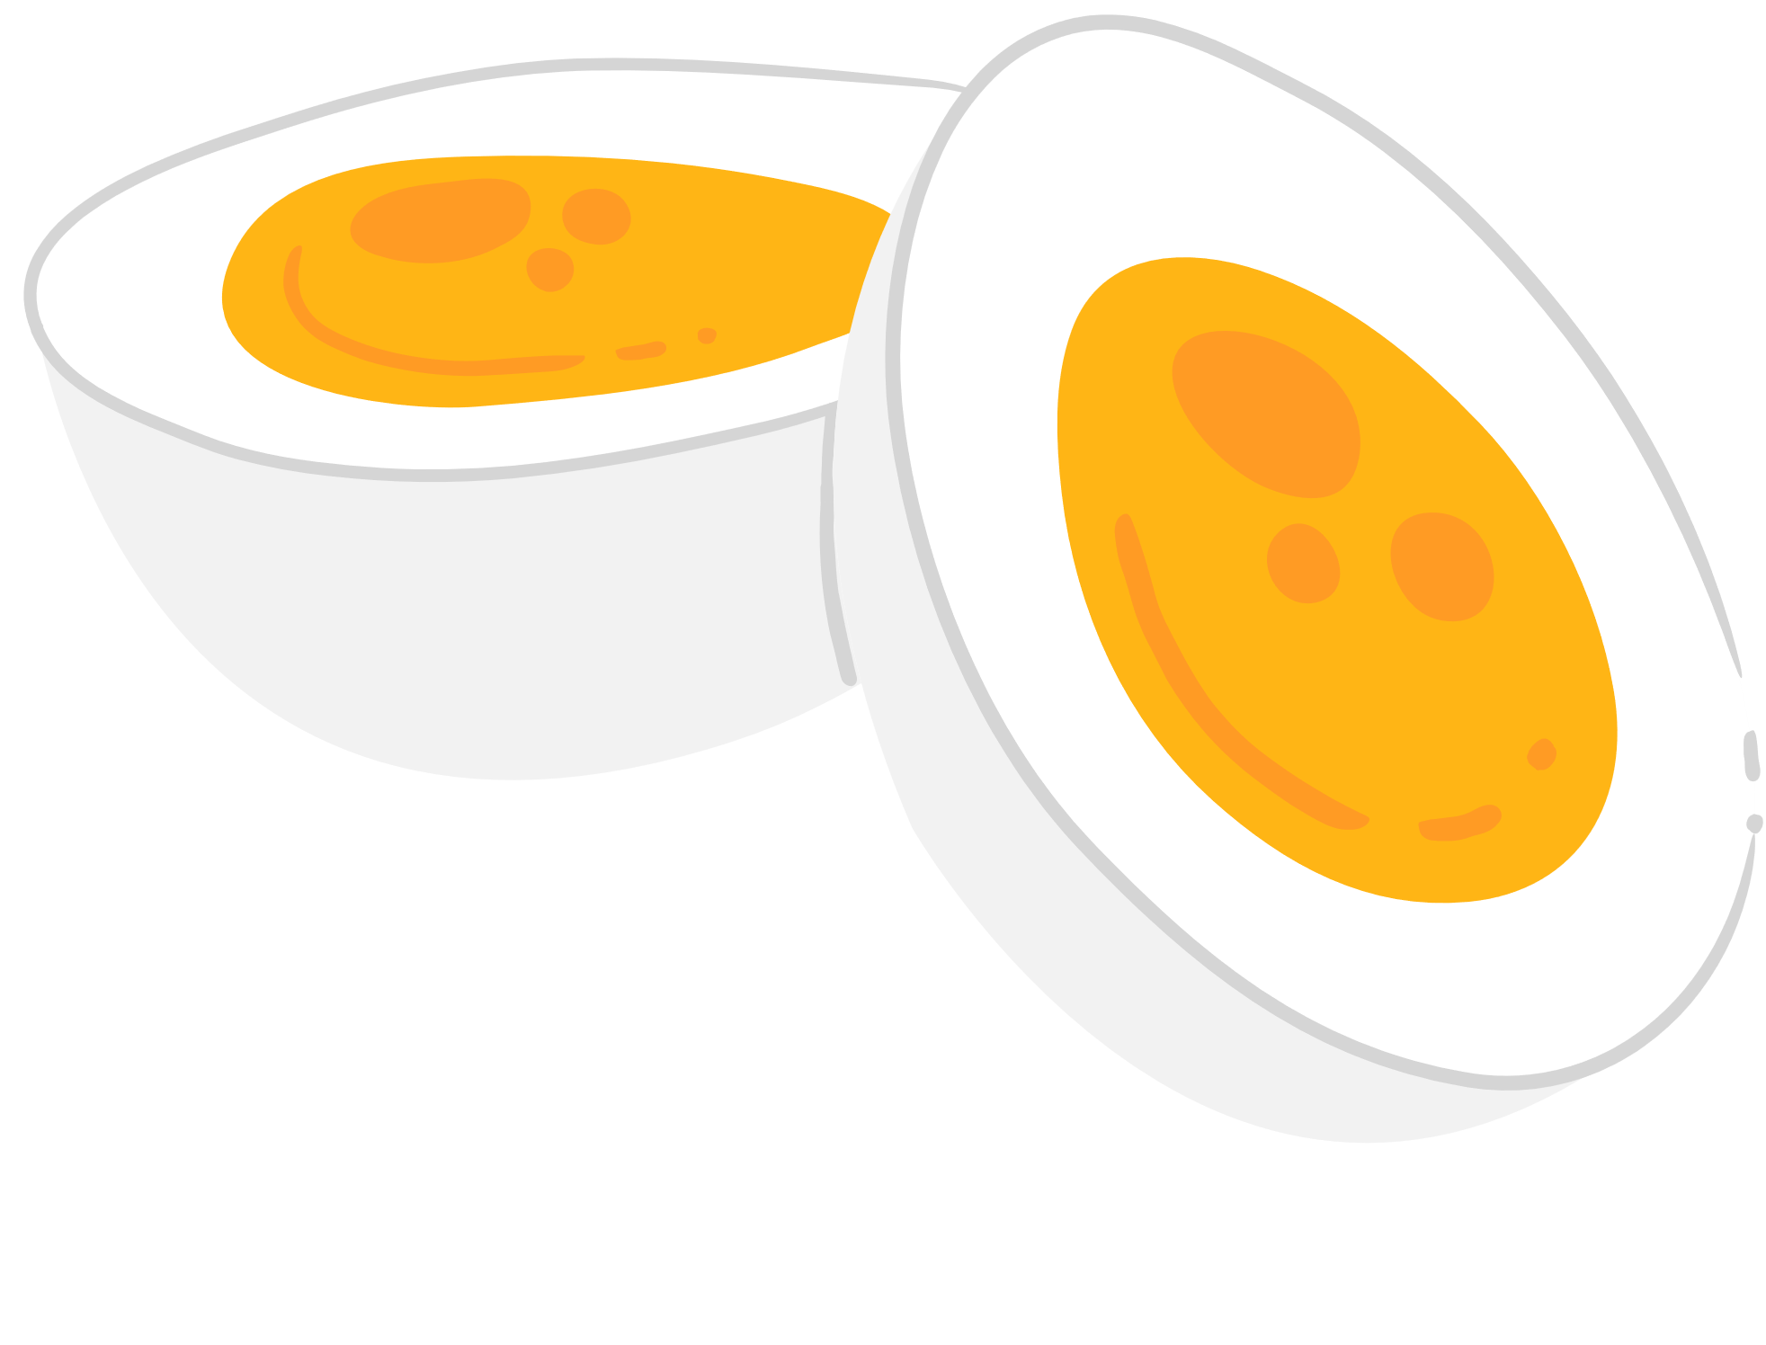



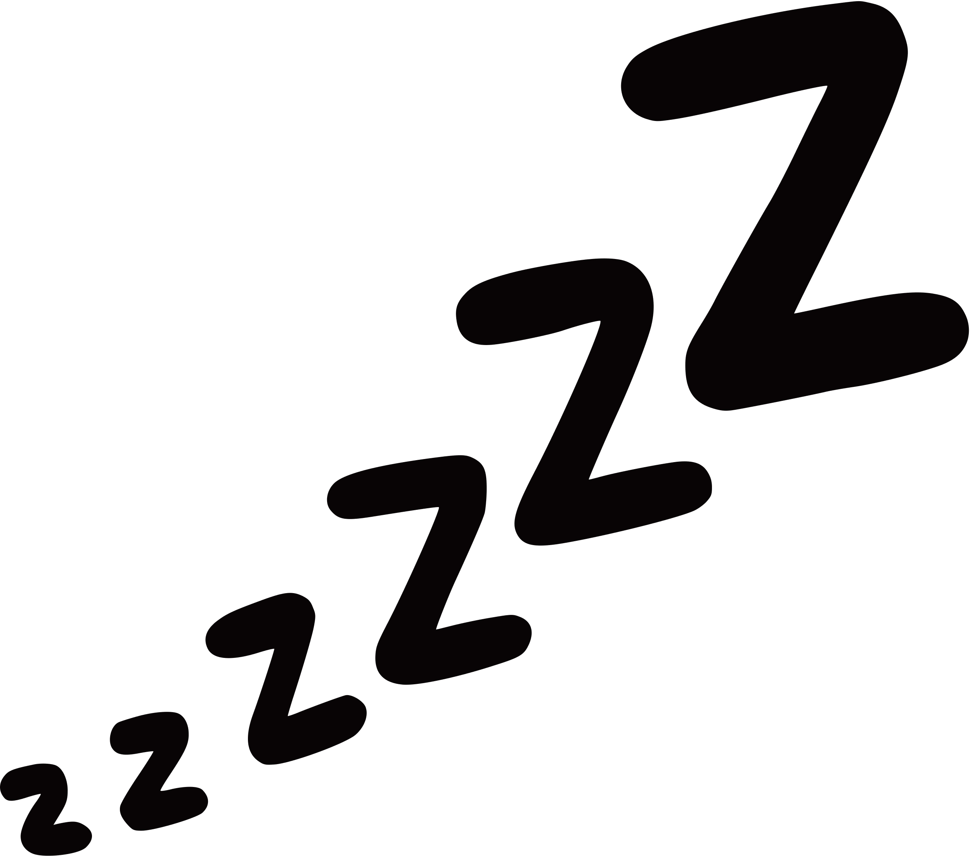
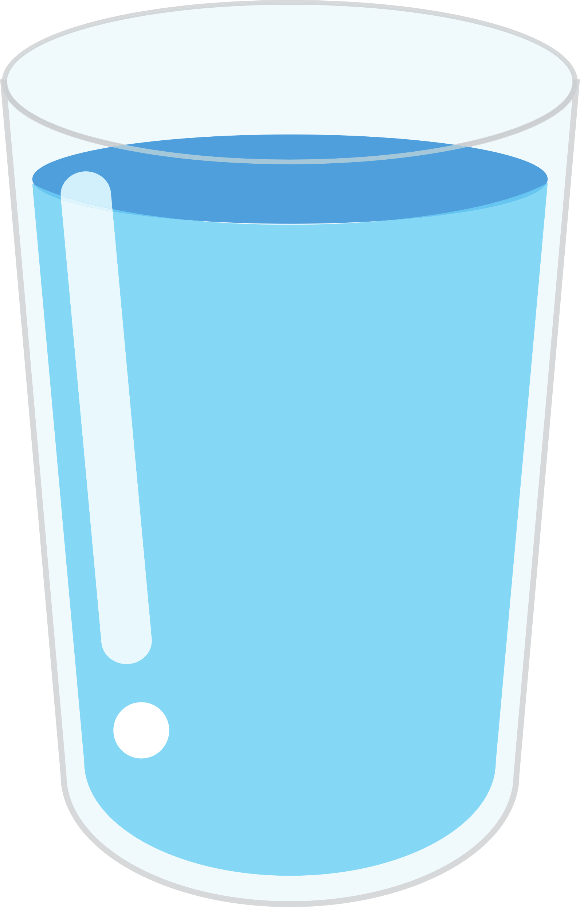


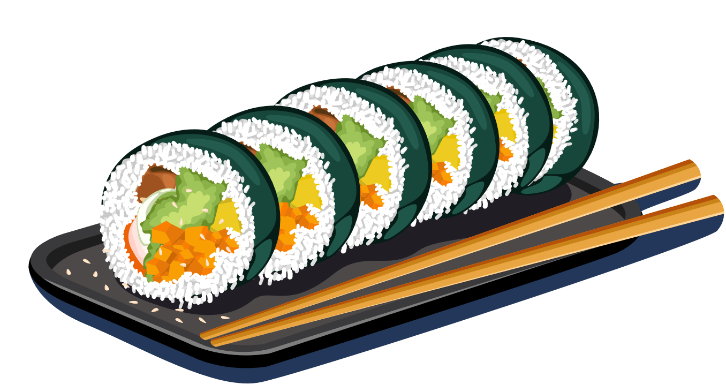
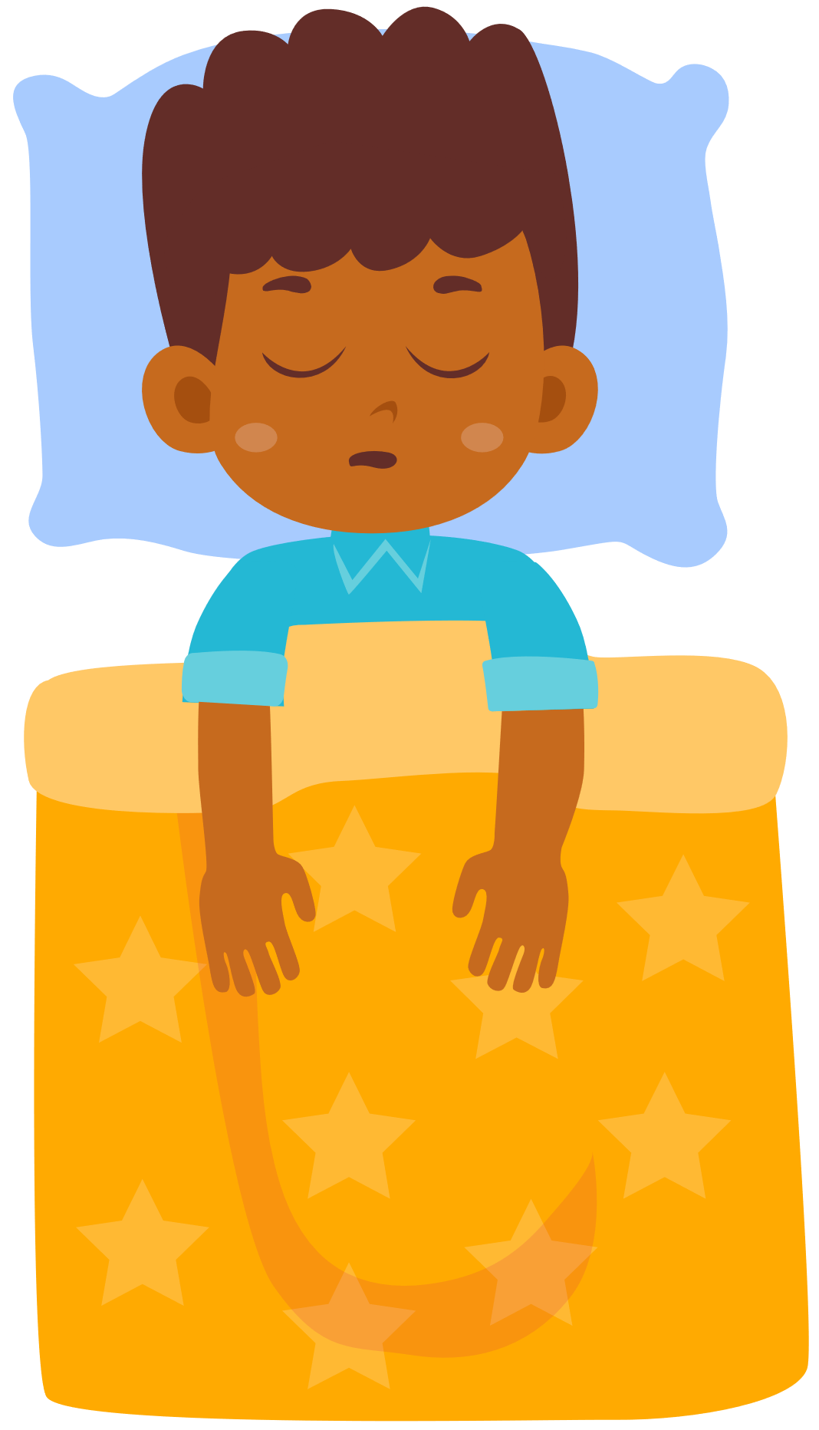

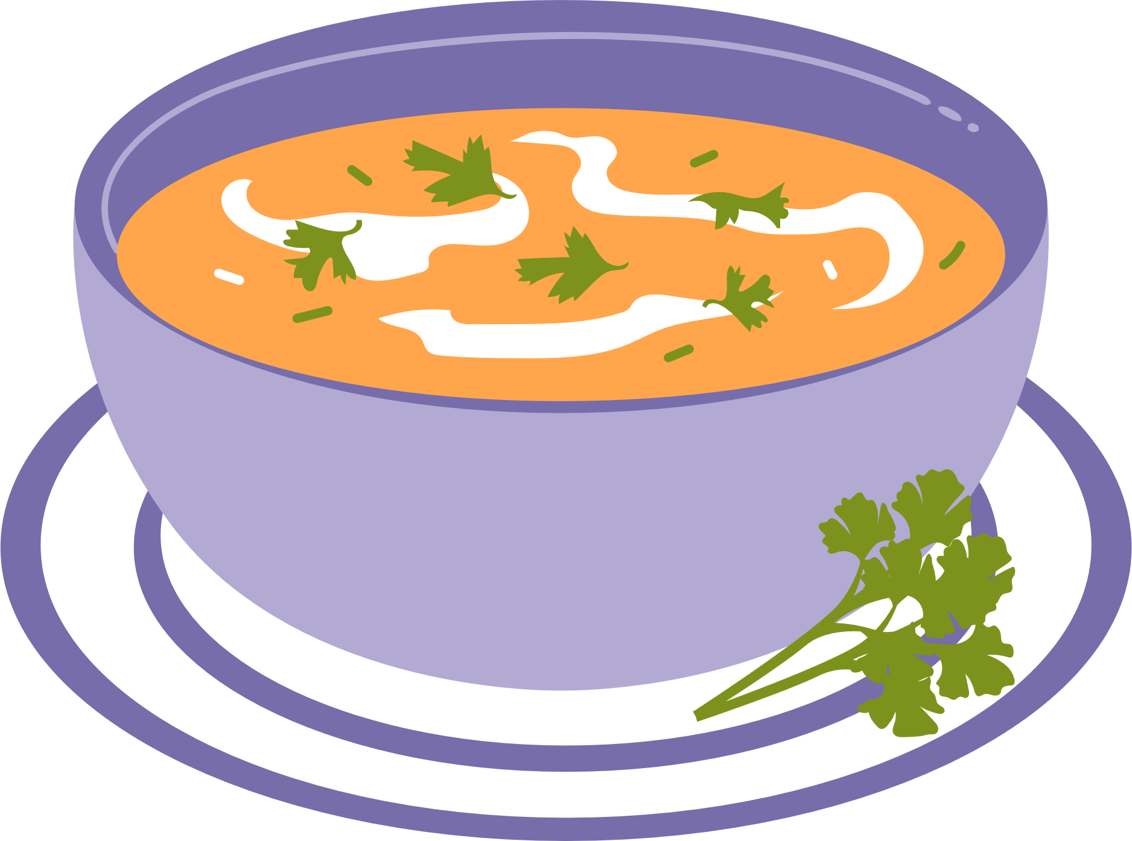
WHAT DOES PHYSICAL
HEALTH LOOK LIKE?
Notes:
We are here for to discuss how you can keep your brains and bodies happy and healthy.
Ask the class: What does physical health look like?
We will be learning about physical health: how to take care of our body through movement, food, and sleep. We’ll learn to understand our bodies’ signals and having fun together while we do this! Today we are going to start by talking about movement and physical literacy.
Some other actions that build physical health: oral hygiene, hand washing, getting your eyes checked by an eye doctor, and getting regular immunizations.
Notes: Asking the students what physical health means for them gives you a chance to assess their understanding so far, and to deliver the content in this module in a way that builds on the strengths in the room.
Option to open a discussion about the Medicine Wheel and how physical health fits into that. Indigenous Medicine Wheel, Sacred Circle, https://www.ictinc.ca/blog/what-is-an-indigenous-medicine-wheel
Physical-Mental-Emotional-Spiritual
https://www.fnha.ca/wellness
https://www.fnha.ca/WellnessSite/WellnessDocuments/NAHO-Traditional-Knowledge-Toolkit.pdf

Slide 8

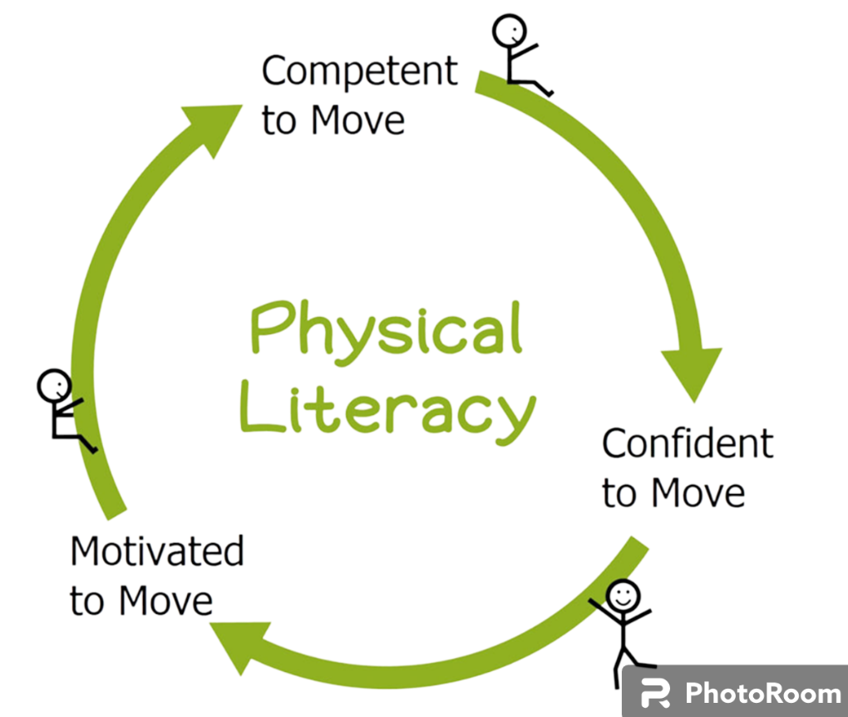
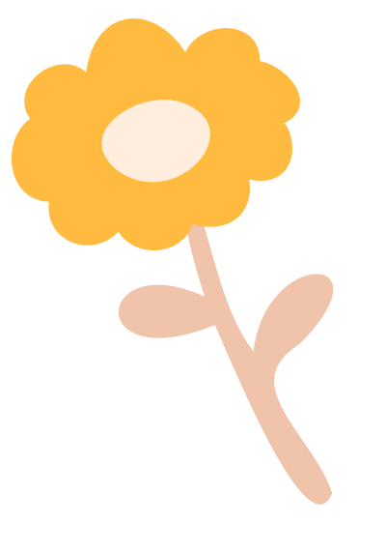
Physical Literacy Wheel
Everyone
Meaningful Movement
Everywhere
More Often
Notes:
In order to move our bodies, we need physical literacy.
Physical literacy (PL) refers to ‘motivation, confidence, physical competence, knowledge and understanding to value and take responsibility for engagement in physical activities’ (Whitehead, 2016). Building up our fundamental movement skills helps us developing competency for movement, which makes us feel more confident moving our bodies, which then makes us more motivated to continue moving, playing, and having fun. PL is the building blocks for us to live an active, healthy and happy life!
Our hope is to see everyone engaging in meaningful movement, everywhere, and more often!
Notes: Emphasize the virtuous cycle.
You can connect this learning to the students by asking them how they feel when they learn a new skill and become good at it (gain confidence).

Slide 9

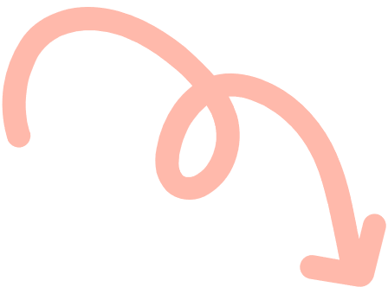
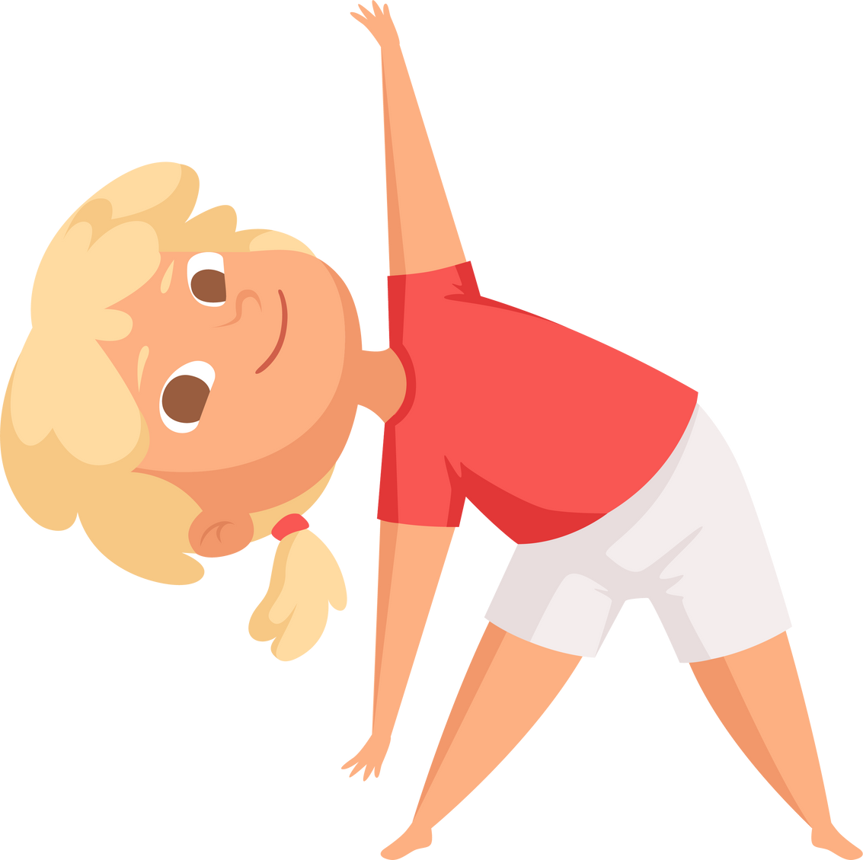

What is …. physical literacy?
Notes:
This video will explain what Physical Literacy is and why we need to care about it. The two characters in this video identify as a boy and a girl, but we know that children of all diverse genders can develop physical literacy!
Notes: To meet the needs of all learners, here is a video that may speak more for students that are stronger visual / auditory learners
*Note- can adjust the speed if the video if needed. (Video embedded on the following slide).

Slide 10
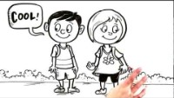
Notes:
This video will explain what Physical Literacy is and why we need to care about it. The two characters in this video identify as a boy and a girl, but we know that children of all diverse genders can develop physical literacy!
Notes: To meet the needs of all learners, here is a video that may speak more for students that are stronger visual / auditory learners
*Note- can adjust the speed if the video if needed.

Slide 11
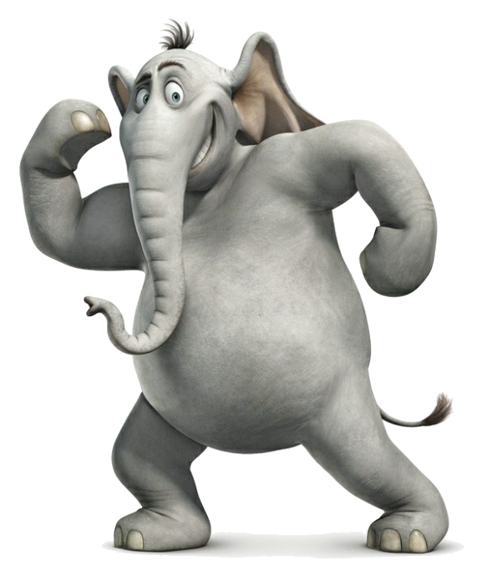
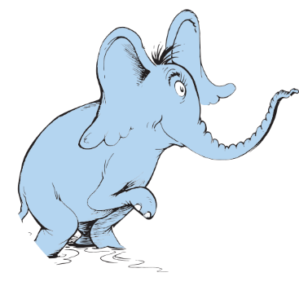
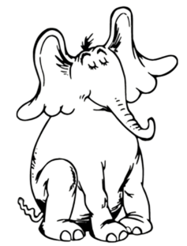
“A person’s
A person,
No matter
How small.”
… or BIG
Dr. Seuss – Horton Hears a Who!
Seuss, D. Horton Hears a Who! New York: Random House, 1954.
Notes:
In this class, each and every one of you has an AMAZING body. This slide conveys the fact that people (and elephants!) come in all shapes and sizes.
Body size and shape are determined mostly by genetics.
Taking care of our physical health allows us to have fun and play with friends. Moving our bodies every day, having a good night’s sleep and nourishing our bodies gives us the energy and strength to play, learn and grow - and it feels good!
In your classroom, we have all kinds of games you can play to get moving for an hour each day!
Notes: (next slide is a movement break)
This slide is intended to set the stage for an inclusive environment that encourages everyone to move
Emphasize how we all have different bodies and brains
A reminder about a key principle related to VCH values and key messages for promoting healthy eating amongst children: to focus on fostering positive relationships with food and body, in a weight-inclusive way. This means focusing on body’s function rather than weight or size, and fostering acceptance and valuing diversity

Slide 12

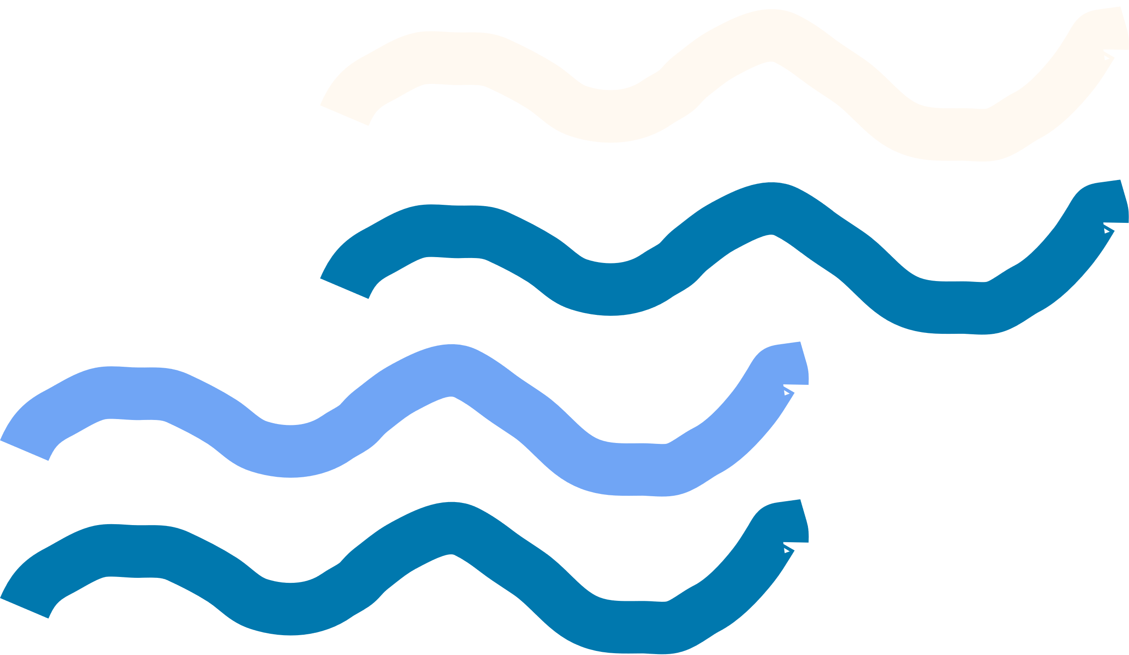

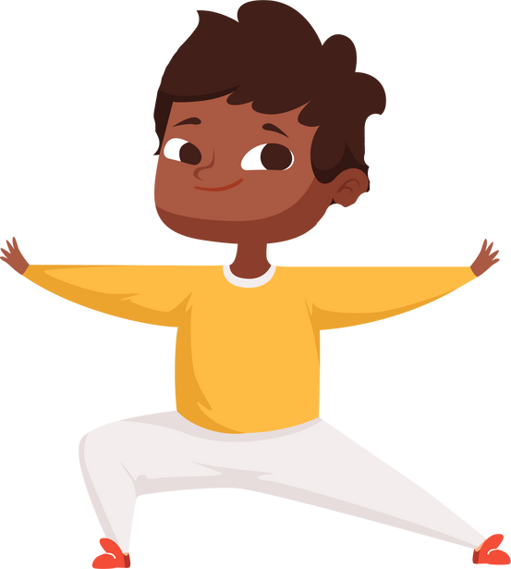


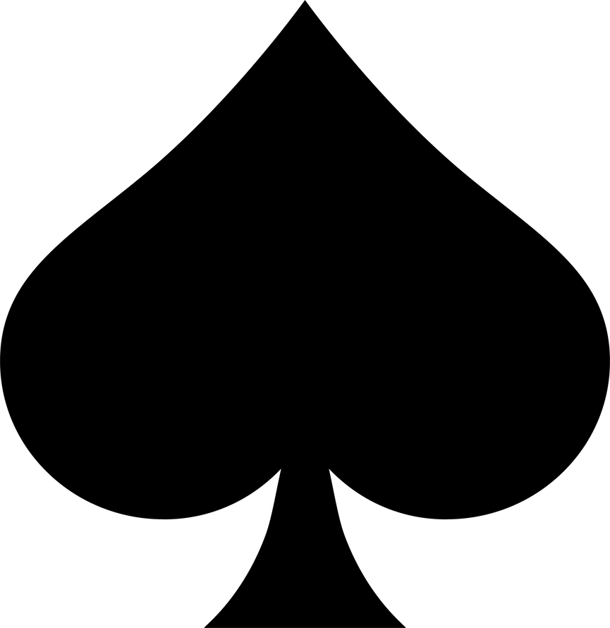


Movement Break!
Deck of Cards Fitness
Jumping
Jacks
Toe
Touches
Squat
Arm
Circles
Notes:
Movement Break!
Now that you know what physical literacy is, let’s move using our physical literacy skills
… Remember the more skills we have, the more we can move and the more fun we have!
Introduce Deck of Card Fitness:
The game we’re going to play is called “Deck of Card Fitness”.
It is an easy and FUN way to practice our physical literacy skills!
I’m going to pull a card. The number represents the number of times we will do the activity (e.g. aces = 1, 2 = 2,... face cards = 10).
And the shape of the card represents the skill we are practicing.
Note: When explaining the various card shapes and the skill to practice, recommend demonstrating a few repetitions for the class so they understand (student’s reading levels may vary)

Slide 13

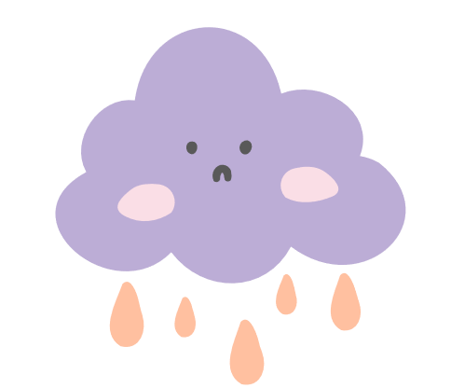
Why do we need to care?
ParticipACTION
Report Card 2022
Most students your age are not
meeting their recommended physical activity levels (60 minutes a day)
Notes:
To be able to participate in all types of play, games, and sports with our classmates, it's important for us to learn the skills we need to move well and safely. For example, once we learn how to balance, we can dance, walk across a log, go kayaking, go skateboarding, help an elder cross the street, or participate in gymnastics; once we learn how to run, we can play tag, soccer, lacrosse, track n’ field, snowshoe or go sledding....the opportunities are endless.
Unfortunately, not all Canadian kids are moving enough every day to be able to experience the benefits of moving, but we think you can help!
Right now, over half of Canadian kids are not moving enough. Instead of moving and playing with friends and family, we’re finding students spending their time on screens instead.
Ask the class: When we spend our time on screens, what are some fun things we might miss out on?
When kids spend too much time on screens, they miss out on opportunities to play, cook and eat with their families, and can find it hard to fall asleep at night. Many Canadian kids are not getting enough sleep.

Slide 14
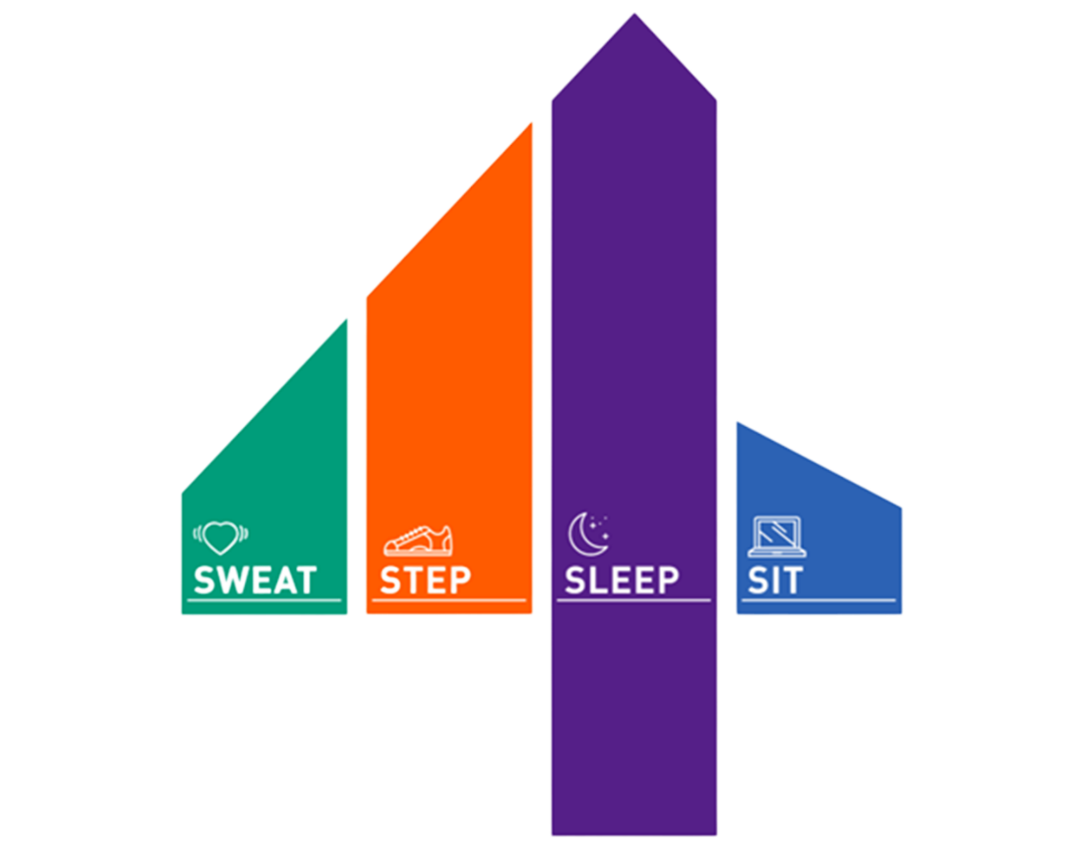
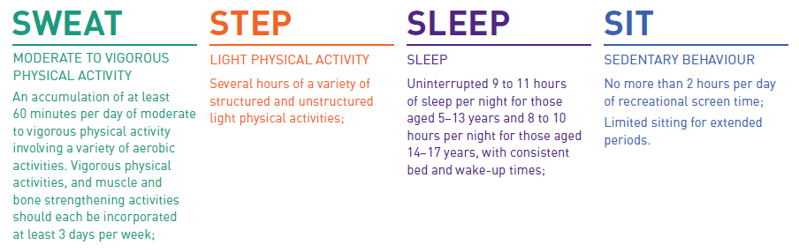
The 24hr Movement
Guidelines
Notes:
The 24 Hour Movement Guidelines were created by Canadian Brain Scientists! They learned what rules we need in our day to keep our brains and bodies happy and healthy.
This number four on the screen represents the number four in ‘24 hours.’ Each colour on the four represents the scientist’s recommendation for how to keep your brain and body healthy and happy.
First, in the green, you can see that the scientists recommend we move our body vigorously and sweat for at least one hour- or 60 minutes- everyday.
But it’s also important that we move our bodies throughout the day too- several hours of light activity - like walking to school, or helping with chores- is part of the orange line.
Next is purple- how many of you go to sleep every night? Sleep is very important because it allows our bodies to recharge after a busy day. Kids in your age group need about 9 to 11 hours every night.
Finally, the blue corner at the end is ‘sit.’ This one is small because it’s best for our bodies not to spend more than two hours sitting on screens everyday. This is about the length of one movie- can you imagine watching more than one movie per day? Sometimes we have to sit for longer periods of time at school or when our parents are at work, which is okay, we just have to take breaks by standing up and moving our bodies in between.
Notes: This slide references the Canadian 24 hour movement guidelines https://csepguidelines.ca/downloads/
These are guidelines relevant to apparently healthy children and youth (aged 5-17 years) irrespective of gender, race, ethnicity, or socioeconomic status of the family.
These guidelines are intended to encourage an active lifestyle with a daily balance of sleep, sedentary behaviours, and physical activities that supports their healthy development.

Slide 15
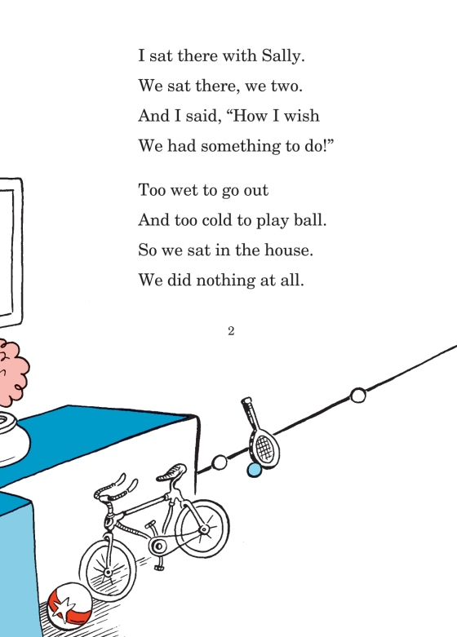
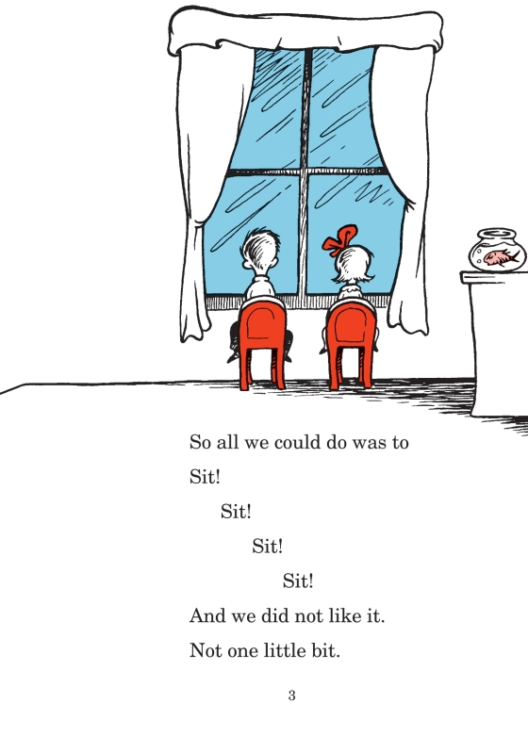
We did not like it. Not one little bit...
Seuss, D. The Cat in the Hat. New York: Random House, 1957.
Notes:
You are all very lucky because you have teachers who care about you and your health and they know that moving throughout the day makes it easier for you to learn and makes your bodies healthy and happy. Moving more often throughout the day, fueling the body with food, and spending time with friends and family and less time on screens helps us keep our bodies healthy, and allows us to do all the things we want to do as we grow older.
Dr. Seuss told us a story in Cat in the Hat that describes really well what the Brain Scientists have been telling us…
Read the poem to the class:
“Too wet to go out and too cold to play ball.
So we sat in the house. We did nothing at all.
So all we could do was to Sit! Sit! Sit! Sit!
And we did not like it. Not one little bit.”

Slide 16
What happens to our brain and how do we feel when all we do is...
Sit!
Sit!
Sit!?
Notes:
Ask the class: What happens to our brains when all we do is sit sit sit?!
And how does that make us feel?
Notes: there are many ways teachers can engage the classroom in questions while incorporating movement. The intention of delivering these modules in classrooms is to model for teachers what it could look like and to add a few “tools” into their toolbox. One way to practice fundamental movement skills when asking a class questions, is tossing a soft toy or bean bag to whose turn it is to answer.
Listen for the responses that the students provide
Tip: If a student tosses the object hard towards the instructors face, turn it into a teaching moment. “Wow, that was quite a fast throw. It’s really hard to catch a ball that’s coming quickly towards your head- in our class, team players set their classmates up for success with a nice underarm throw aimed at their hands.

Slide 17
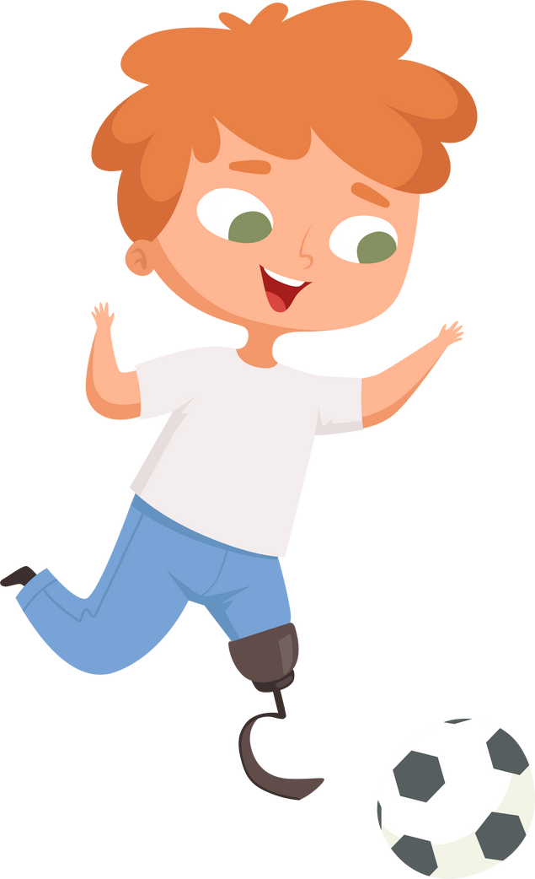
Movement Break!
X Marks the Spot
Notes:
Movement break!
This next game is a way to practice agility, coordination and balance! When we’re feeling like there’s all this energy inside us and it’s about to burst, a quick round of this game can help us to bring that energy from way up high, back down to a level where we can focus and learn in class.
This game is called “X marks the spot”!
Choose 2 volunteers to demonstrate jumping between the lines without touching the tape for 30 seconds - the other students are pretending they are in the x.
You’re going to hop for 20-30 seconds without stepping on the lines of the tape.
Start your timer and go, remind them to keep their shoulders facing front.
How many lateral and forward jumps can they do in 30 seconds without touching the tape? (Or imaginary tape?)
The goal is to keep the feet moving as quickly and accurately as possible.
Bring the class back down: Pulse Check!
Ask the class to take a seat and feel their pulse at their neck. What do they notice? Is it faster? Slower than before? Beating harder? Connect this with the science and benefits of getting the heart rate up!
Notes:
Too easy? using one foot is harder than two feet
Too challenging? Students can hold the wall or a partner's hand - an opportunity for peer support!
Tip for bringing the class back down and ready to listen: Everybody touch your right brain and shake your left leg!
Fun Fact: Moving in all directions trains both sides of the body AND both sides of the students' brain!

Slide 18
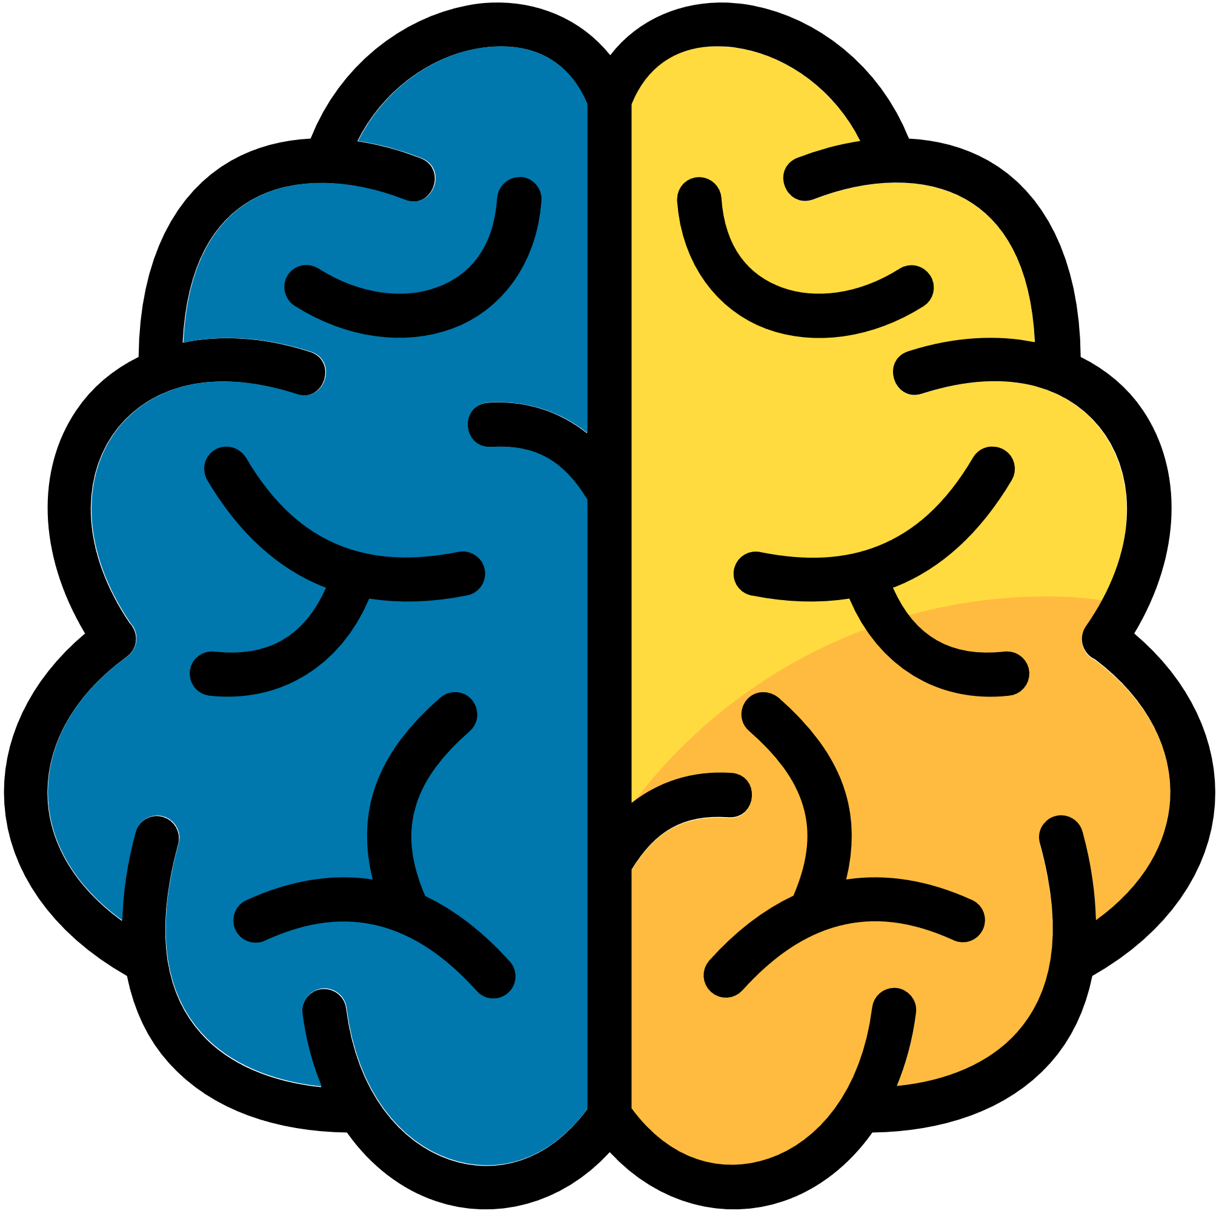

What happens to our brain and how do we feel when we move?
Habits that protect your brain:
Limiting your
screen time
Getting enough sleep
Eating food that helps us grow &
Making water your drink of choice
Physical movement
throughout the day
Social connection
Notes:
Ask the class: What do you think happens to our brains when we move our bodies?
We learned from Dr. Seuss’ and the brain scientists’ sad story that too much sitting and screen time, and not enough fun movement can make us sad…
We also learned that movement can make us feel good! …
Ask the class: What are some habits that can promote a healthy and happy brain? What can we do to take care of our brains and bodies?
Notes:
Focus on emphasizing health-promoting language and listen for diet culture. As public health practitioners, it is important to acknowledge that food choices are influenced by many factors, including the determinants of health and often are outside of children’s control. Naming certain foods as “good” or “bad” can foster feelings of guilt and may perpetuate stigma.
Some examples:
Instead of what not to eat (e.g. sugary foods), emphasize what to eat more of (e.g. nutrient dense vegetables, fruit, plant-based proteins, whole grains)
Instead of hyperfocusing on “what”, encourage “how” of eating (e.g. using senses to enjoy the food such as colours on the plate, texture, and sharing food with friends and family)
Emphasize positive functions of food such as e.g. “food that helps us live, grow, learn in school / about culture”
This is a chance to connect to community, culture and everyday living
What are some family rituals that promote health? (e.g. going to the park on weekends)

Slide 19
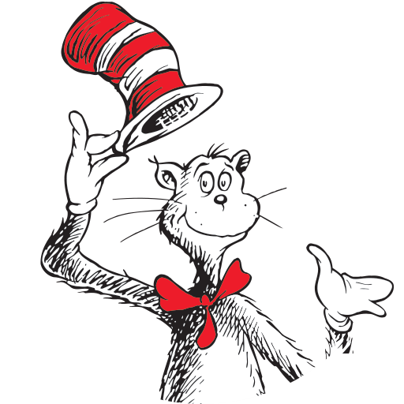
Dr. Seuss has a solution
“You have brains in your head.
You have feet in your shoes
You can steer yourself
any direction you choose.”
“And will you succeed?
Yes! You will, indeed!
(98 and 3 / 4 percent guaranteed.)”
“I have brains in my head.
I have feet in my shoes
I can steer myself
  any direction I choose.”
Seuss, D. The Cat in the Hat. New York: Random House, 1957.
Notes:
Incredible ideas, class!
Dr. Seuss has some great tips for our lesson today, reminding us that we have the power to turn the sad story into a happy ending.
Read the poem from Dr. Seuss, and for the last paragraph (in blue), invite the class to join in as choral reading.
Some classes prefer that you read the first line, and then read the same line again altogether
And follow that same pattern, line by line

Slide 20

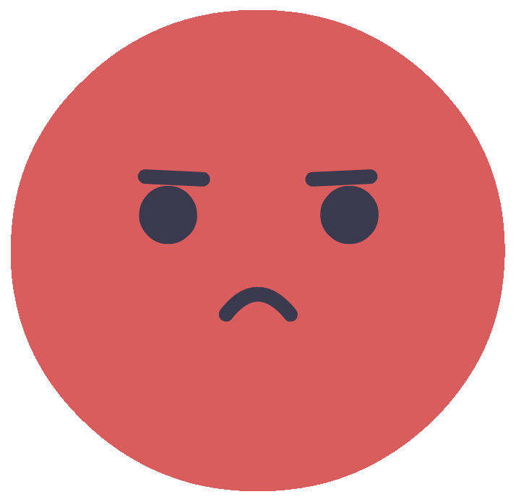
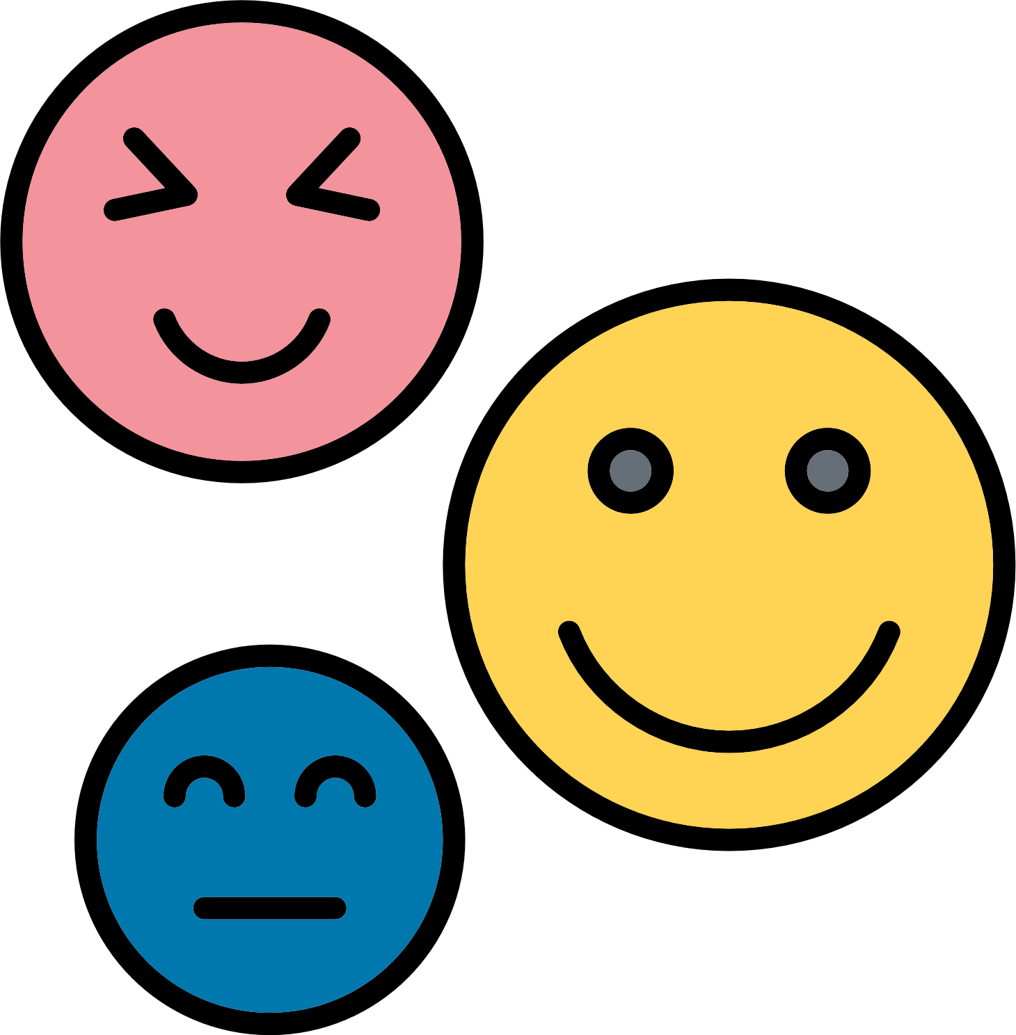

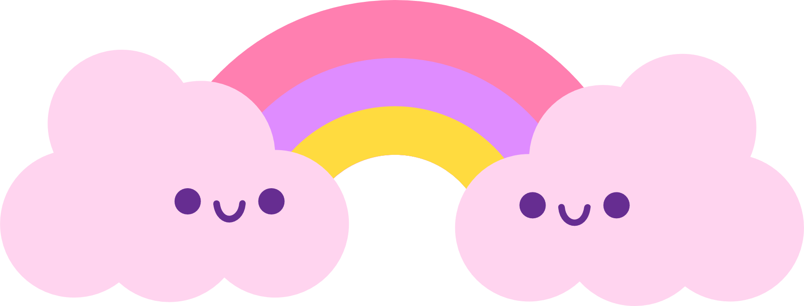
How do you feel now?
Notes:
Learning is iterative, and repetition is key! Recap:
That was incredible! We covered a lot in the last 30-40 minutes:
We learned that building our physical literacy skills makes us more confident and allows us to have more fun playing with friends without getting hurt
We practiced our movement skills (squats, toe touches, jumps, hops…. )
We did some sweating and stepping (i.e. 24 hour guidelines)
We learned how the brain and body are connected (tap the left brain and right leg to remind students of the brain-body connection)
…. and that movement, sleep, and food make our brains and bodies happy and healthy!
Ask the class:
While we learned all that, we did a lot of moving! Now, let’s take a deep breath… breathe in….4-3-2-1… breath out… 3-2-1.
Notice how you feel now…. Do you feel any different?
Notes:
Checking in with the students at the beginning and end of class are important.
At the end of class, this gives a chance for students to notice the difference - and experience the message that’s being conveyed around “why” movement is important. This also gives teachers a chance to notice how these movement breaks help students regulate, and prepare to be better learners in class! (e.g. Did we wake up the tired people? Help students to calm and listen better? Feel happier?)

Slide 21
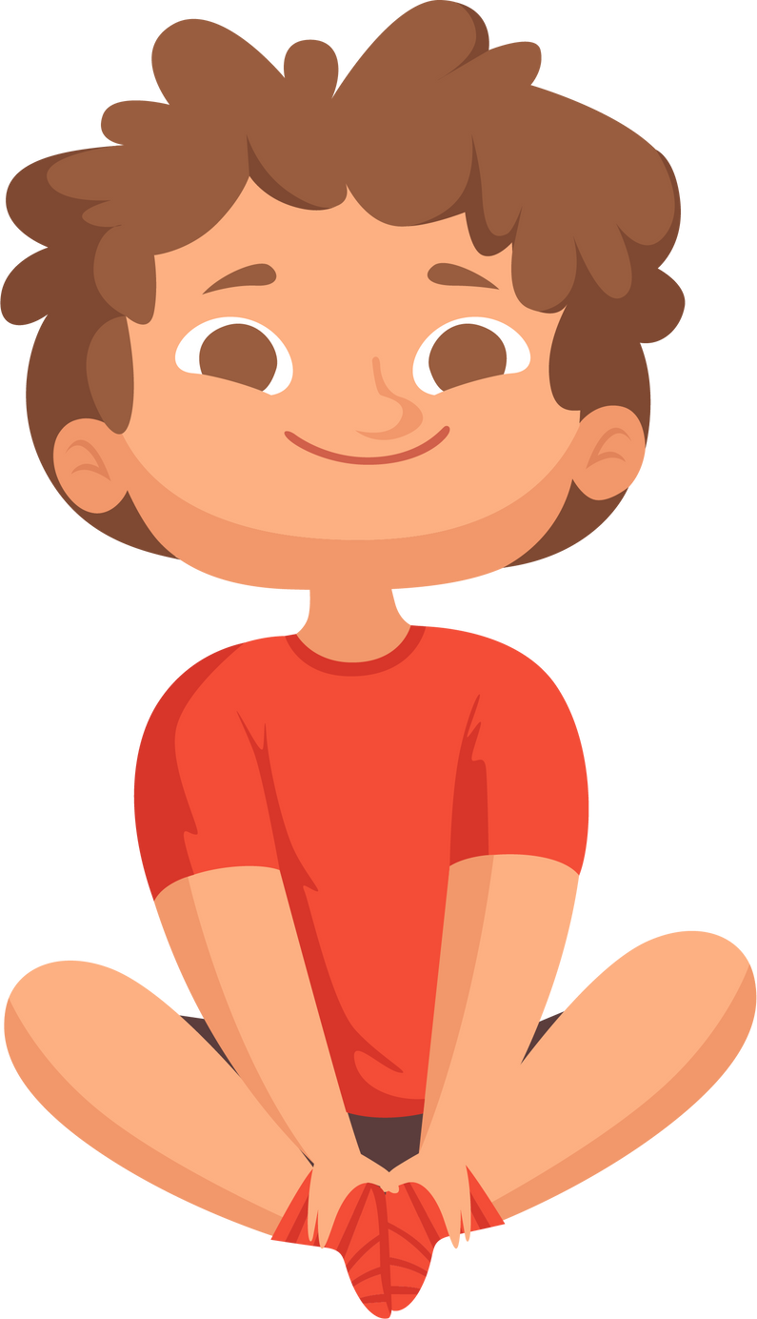
Time For Calmness
Squeeze…
Your Wrists
Your Elbows
Your Shoulders
Your Thumb
Your Fingers
Other Hand
Notes:
As important as it is to engage everyone in meaningful movement, everywhere, and more often, we also need rest!
Let’s do an exercise together as we prepare for the next class your teacher has planned….
Walk the class through the grounding exercise
Notes: Notice who continues to wiggle and who may need a bit more support

Slide 22
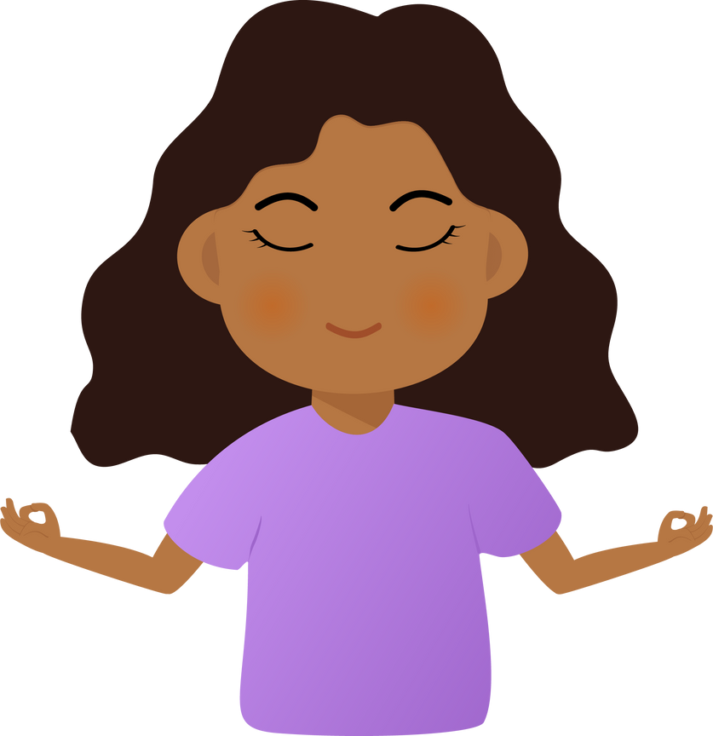
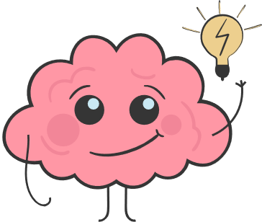
Movement Makes...
Our bodies
  healthier
  Our brains learn better
Our bodies
  calmer and happier
Notes:
Notes: Have students say this message with you.
Movement makes:
Our bodies healthier!
Our brains better learners!
Our bodies calmer and happier!
Note: Thank the class for their engagement and sharing. Let them know that their teacher may continue to bring some of the fun activities into their classrooms.
The module manual accompanying these lecture slides can be left with the teacher as a reminder of the key concepts and as a tool to confidently bring these lessons into their classroom. Follow up with the teacher on sending them any lesson plans or supportive material.

Slide 23








Thank you to our contributors!

