Slide 1


  A note on formatting:
  Each slide comes with key speaking and instructional information for PHNs and teachers in the ‘presenter notes’ part of the powerpoint.
  The font in italics is a script outline- suggestions of words you could say verbally on that slides.
  The “Notes:” unitalicized sections include instructions and tips for the PHN and teacher that are not meant to be read out loud
  Slide background is coloured accordingly: beige = lesson, blue = interactive activity, teal = optional
PILOT: January 2024
School Health Promotion:
Physical Health
Physical Literacy & Sleep: Rest and Reset
Module #4
Last revised: January 2, 2024

Slide 2
PILOT: January 2024
School Health Promotion:
Physical Health
PHN Name, Role
& Fun Fact
Notes:
Introduce yourself as a PHN—Name, Role--Who you are, what you do, why you're here, and a fun fact. Option: add a photo of pet, hobby, or fun fact
Share something with the students that will help build rapport (e.g., mention that you have a cat or dog, or you like to play soccer, or explain why you’re passionate about health promotion).

Slide 3

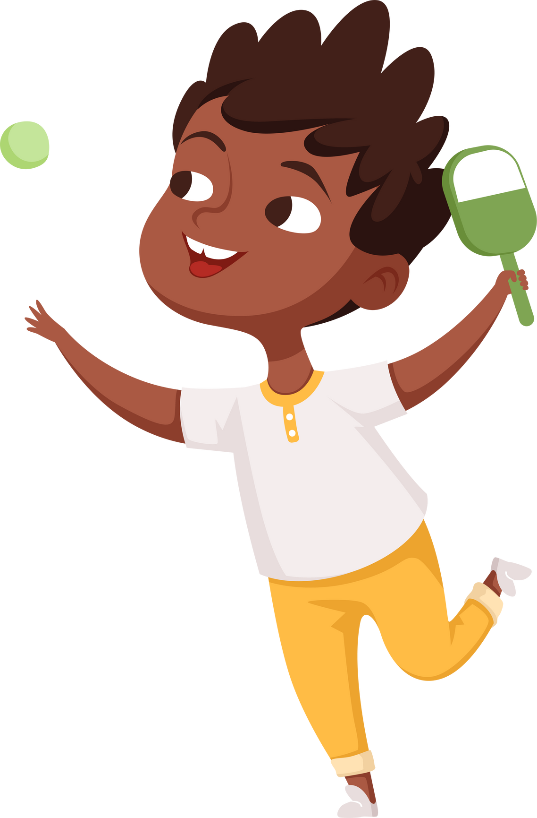

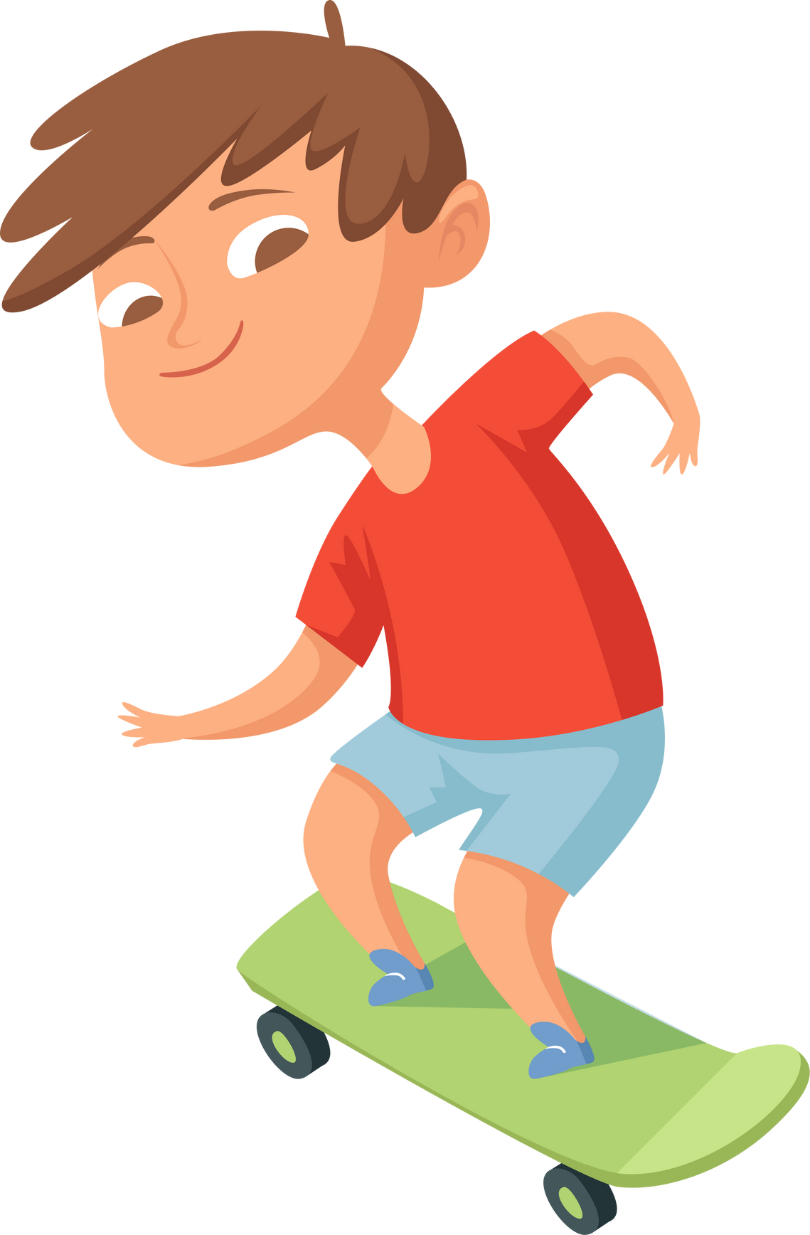
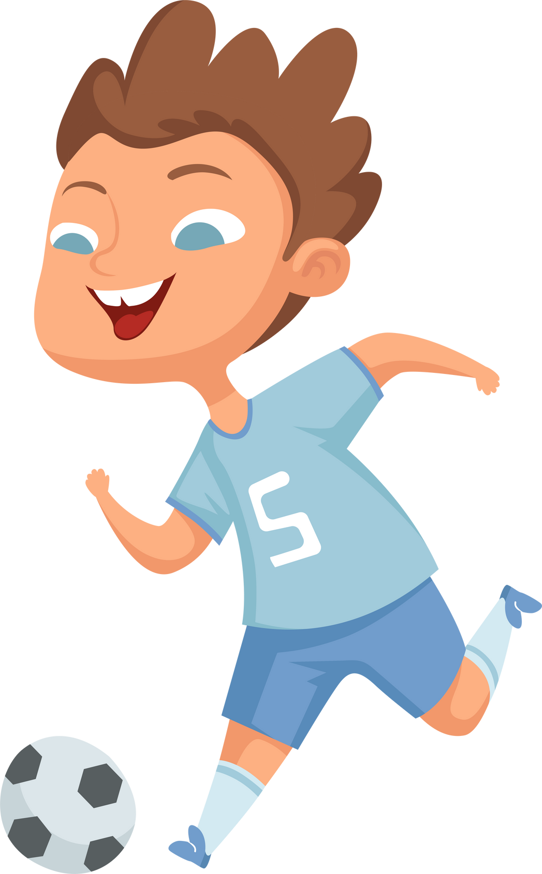


Physical Health
Rest and Reset
PILOT: January 2024

Slide 4

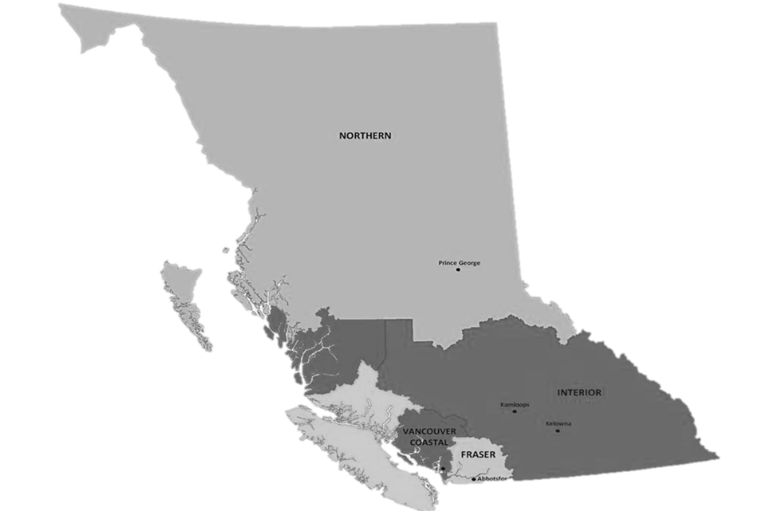
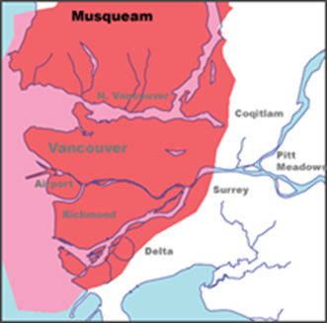
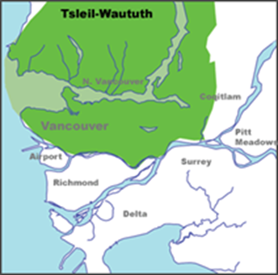
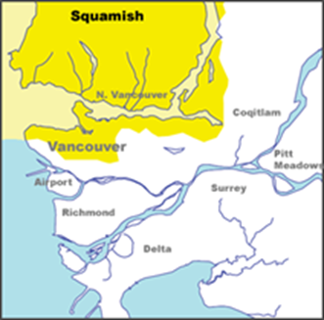
Land Acknowledgment
  We wish to acknowledge that the land on which we gather is the traditional and unceded territory of the Coast Salish Peoples, including the Musqueam, Squamish, and Tsleil-Waututh Nations.
Vancouver Coastal Health is committed to delivering exceptional care to 1.2 million people, including the First Nations, Métis and Inuit, within the traditional territories of the Heiltsuk, Kitasoo-Xai'xais, Lil'wat, Musqueam, N'Quatqua, Nuxalk, Samahquam, shíshálh, Skatin, Squamish, Tla'amin, Tsleil-Waututh, Wuikinuxv, and Xa'xtsa.
Notes:
Notes:
A territory acknowledgement is a relational process. This means that the meaning and purpose changes across time and space, and with the specific context in which it takes place. Take some time to learn about the territory on which the school you are in is situated and connect the honouring to the context of the classroom and module concepts. We encourage you to expand upon your territory acknowledgements in a meaningful way.

Slide 5


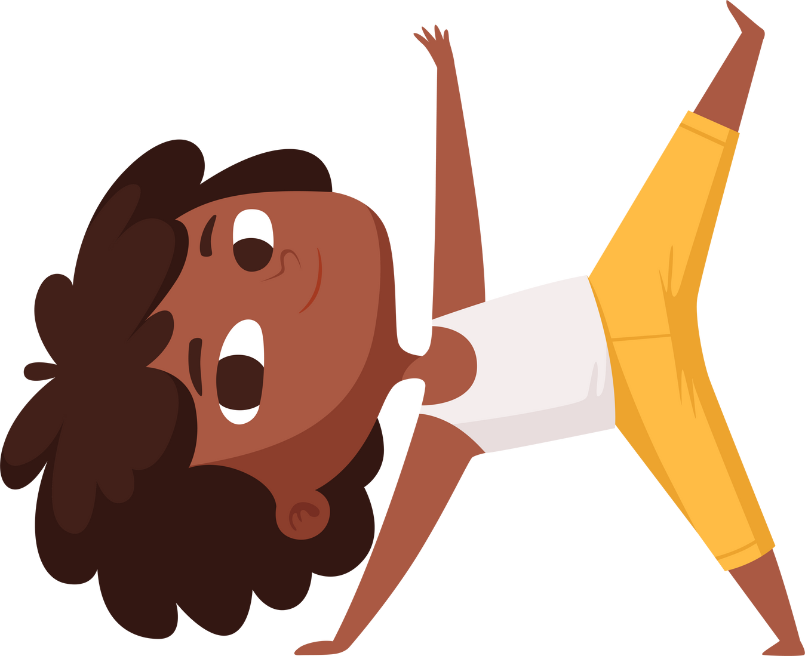

Check in:
What is my body telling me?
  Squat for “NO”
  Hop for “YES”
Notes:
Last time we talked about learning to recognize our body’s signals so that we can respond to meet it’s needs. Let’s check in with our bodies to find out what it’s telling us today.
Check in with Class: "What Is My Body Telling Me?"
Squat for “No,” hop for “Yes.”
Are you energetic?
Are you hungry?
Is your body telling your it’s ready to move?
Are you thirsty?
Are you tired?

Slide 6




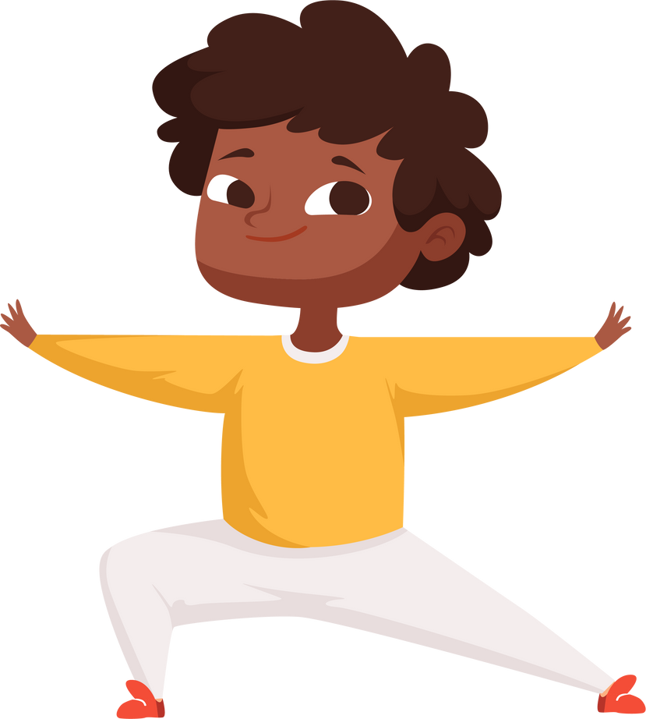
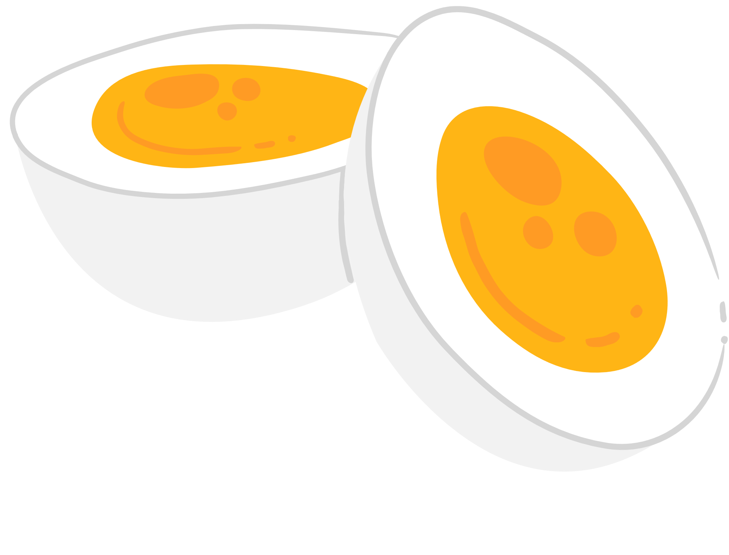






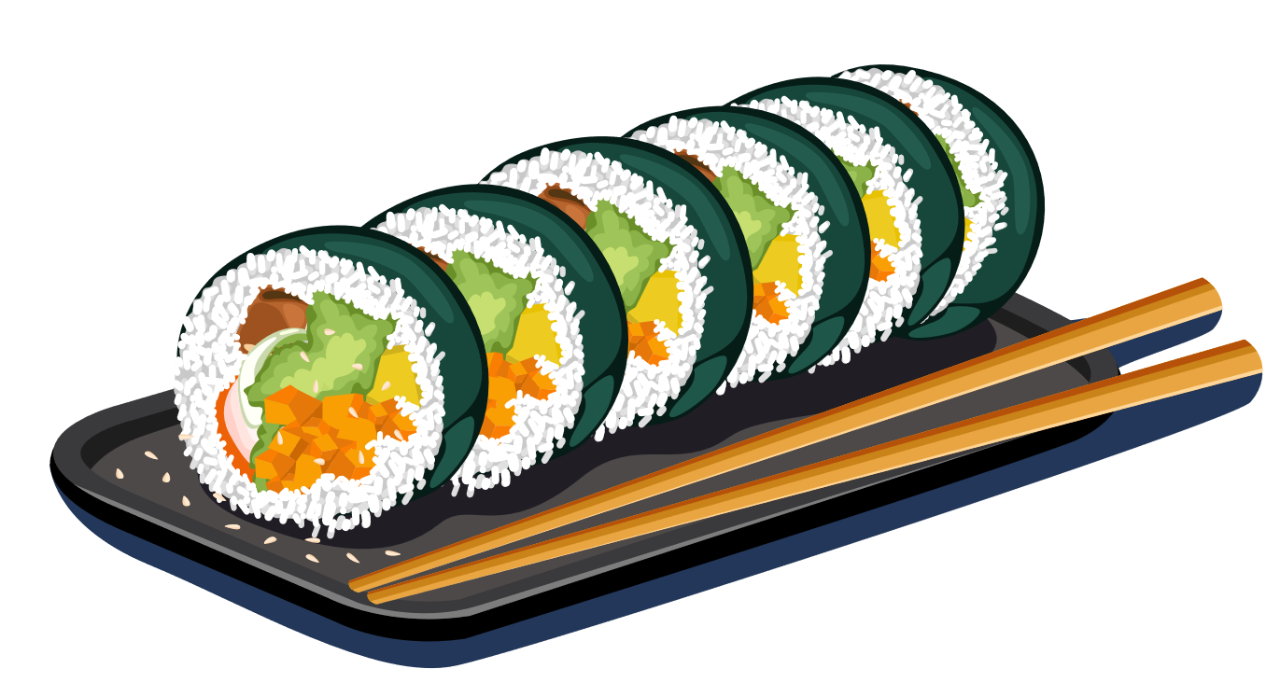
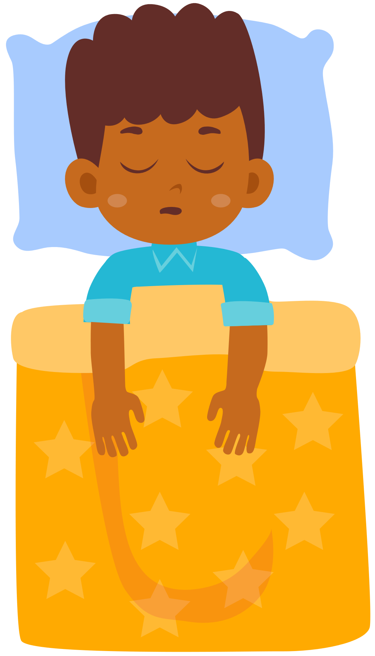

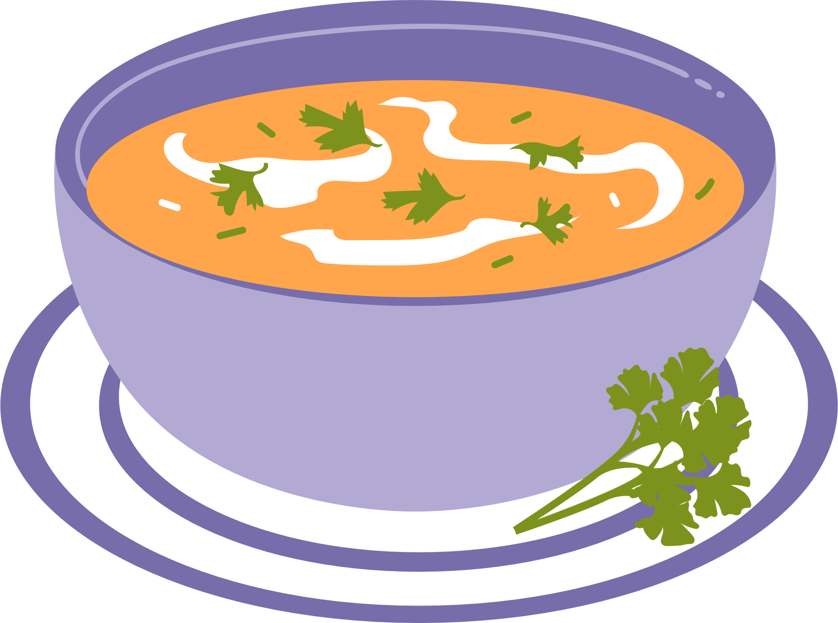
WHAT DOES PHYSICAL
HEALTH LOOK LIKE?
Notes:
In the last three lessons, we learned the importance of food and movement as fuel for our bodies and brains to keep us healthy and strong so we can have fun and do all the things we love like explore, play, learn, help our community and hug our friends and family. Just as important as movement and food is something that we all do without thinking about…. rest! Rest is a key ingredient for looking after our physical and mental health. In this module, we learn more about sleep, rest, and ways to incorporate everything we’ve learned so far.
We will be learning about physical health: how to take care of our body through movement, food, and sleep. We’ll learn to understand our bodies’ signals and having fun together while we do this! Today we are going to start by talking about movement and physical literacy.
Some other actions that build physical health: oral hygiene, hand washing, getting your eyes checked by an eye doctor, and getting regular immunizations.

Slide 7

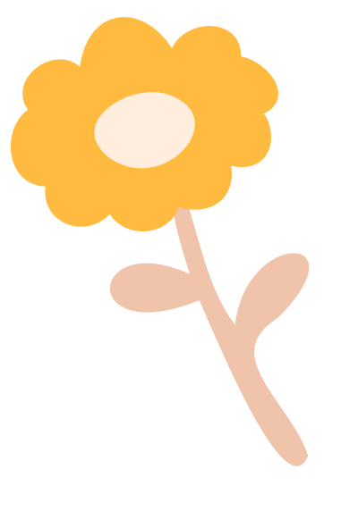
What type of rest do you need?
Physical
Mental
Sensory
Creative
Sleeping;
Yoga;
Stretches
Read a book;
Take a break;
Write in a journal
Listen/play music;
Build or make something
Draw, colour or paint;
Write a story;
Make a craft
Emotional
Social
Spiritual
Express feelings;
Talk with friends
Play or talk with friends and family
Sit quietly with eyes closed;
Help someone
Notes:
There are many kinds of rest…
physical rest
mental rest
social rest
sensory rest
Why is rest important?
Taking time to rest reduces stress, boosts creativity, improves productivity, and enhances decision making. Rest is purposeful time we build into our day, and can happen during activities like: mindfulness, taking deep breaths, reading a book, moving our body- especially mindful activities like yoga or stretching, taking a break from screens, and sleep.

Slide 8
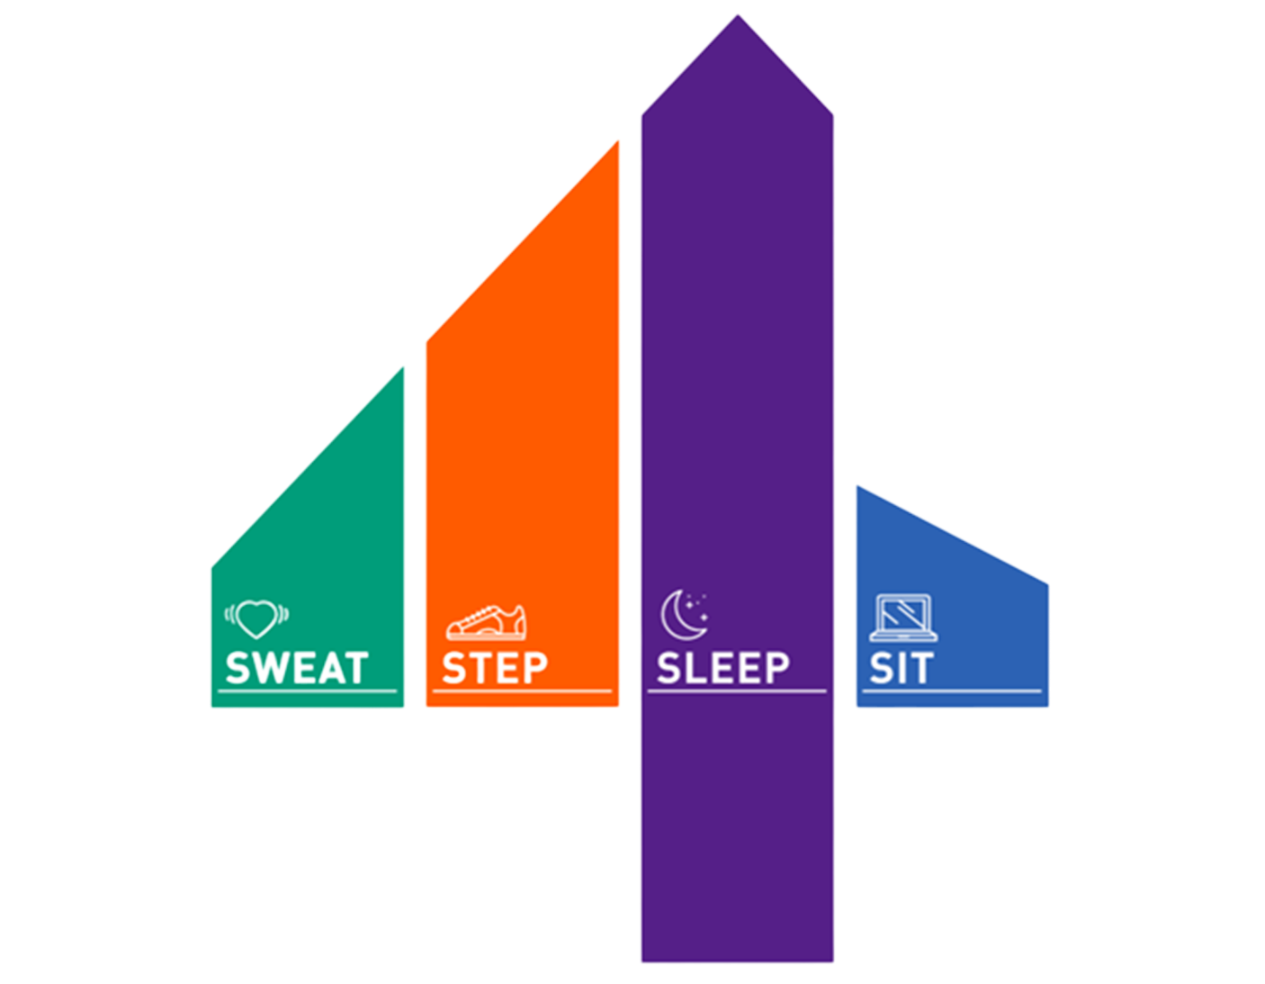
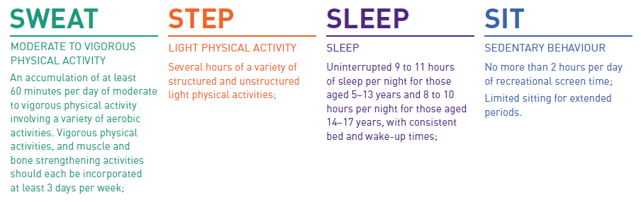
What’s the difference between rest and sleep?
Notes:
Ask the Class: What is the difference between rest and sleep?
SLEEP IS A TYPE OF REST - Do you remember when we learned about the 24hr Movement guidelines? - Sleep is the time when our body and brain rest and recover from the activities of the day.
How much sleep do we need? It depends on how old we are. For children like you, who are 5 to 13 years old, you need about 9-11 hours of sleep every night. That means, if you wake up at 7AM, you should be going to bed between 8 and 10pm. What time do you go to bed?
Ask the Class: What happens when we don’t get enough sleep?
We might feel tired, grumpy and stressed. Have trouble paying attention, remembering things, and solving problems. We might even get sick more often, or have headaches and stomach aches…. that doesn’t sound very fun, does it?

Slide 9

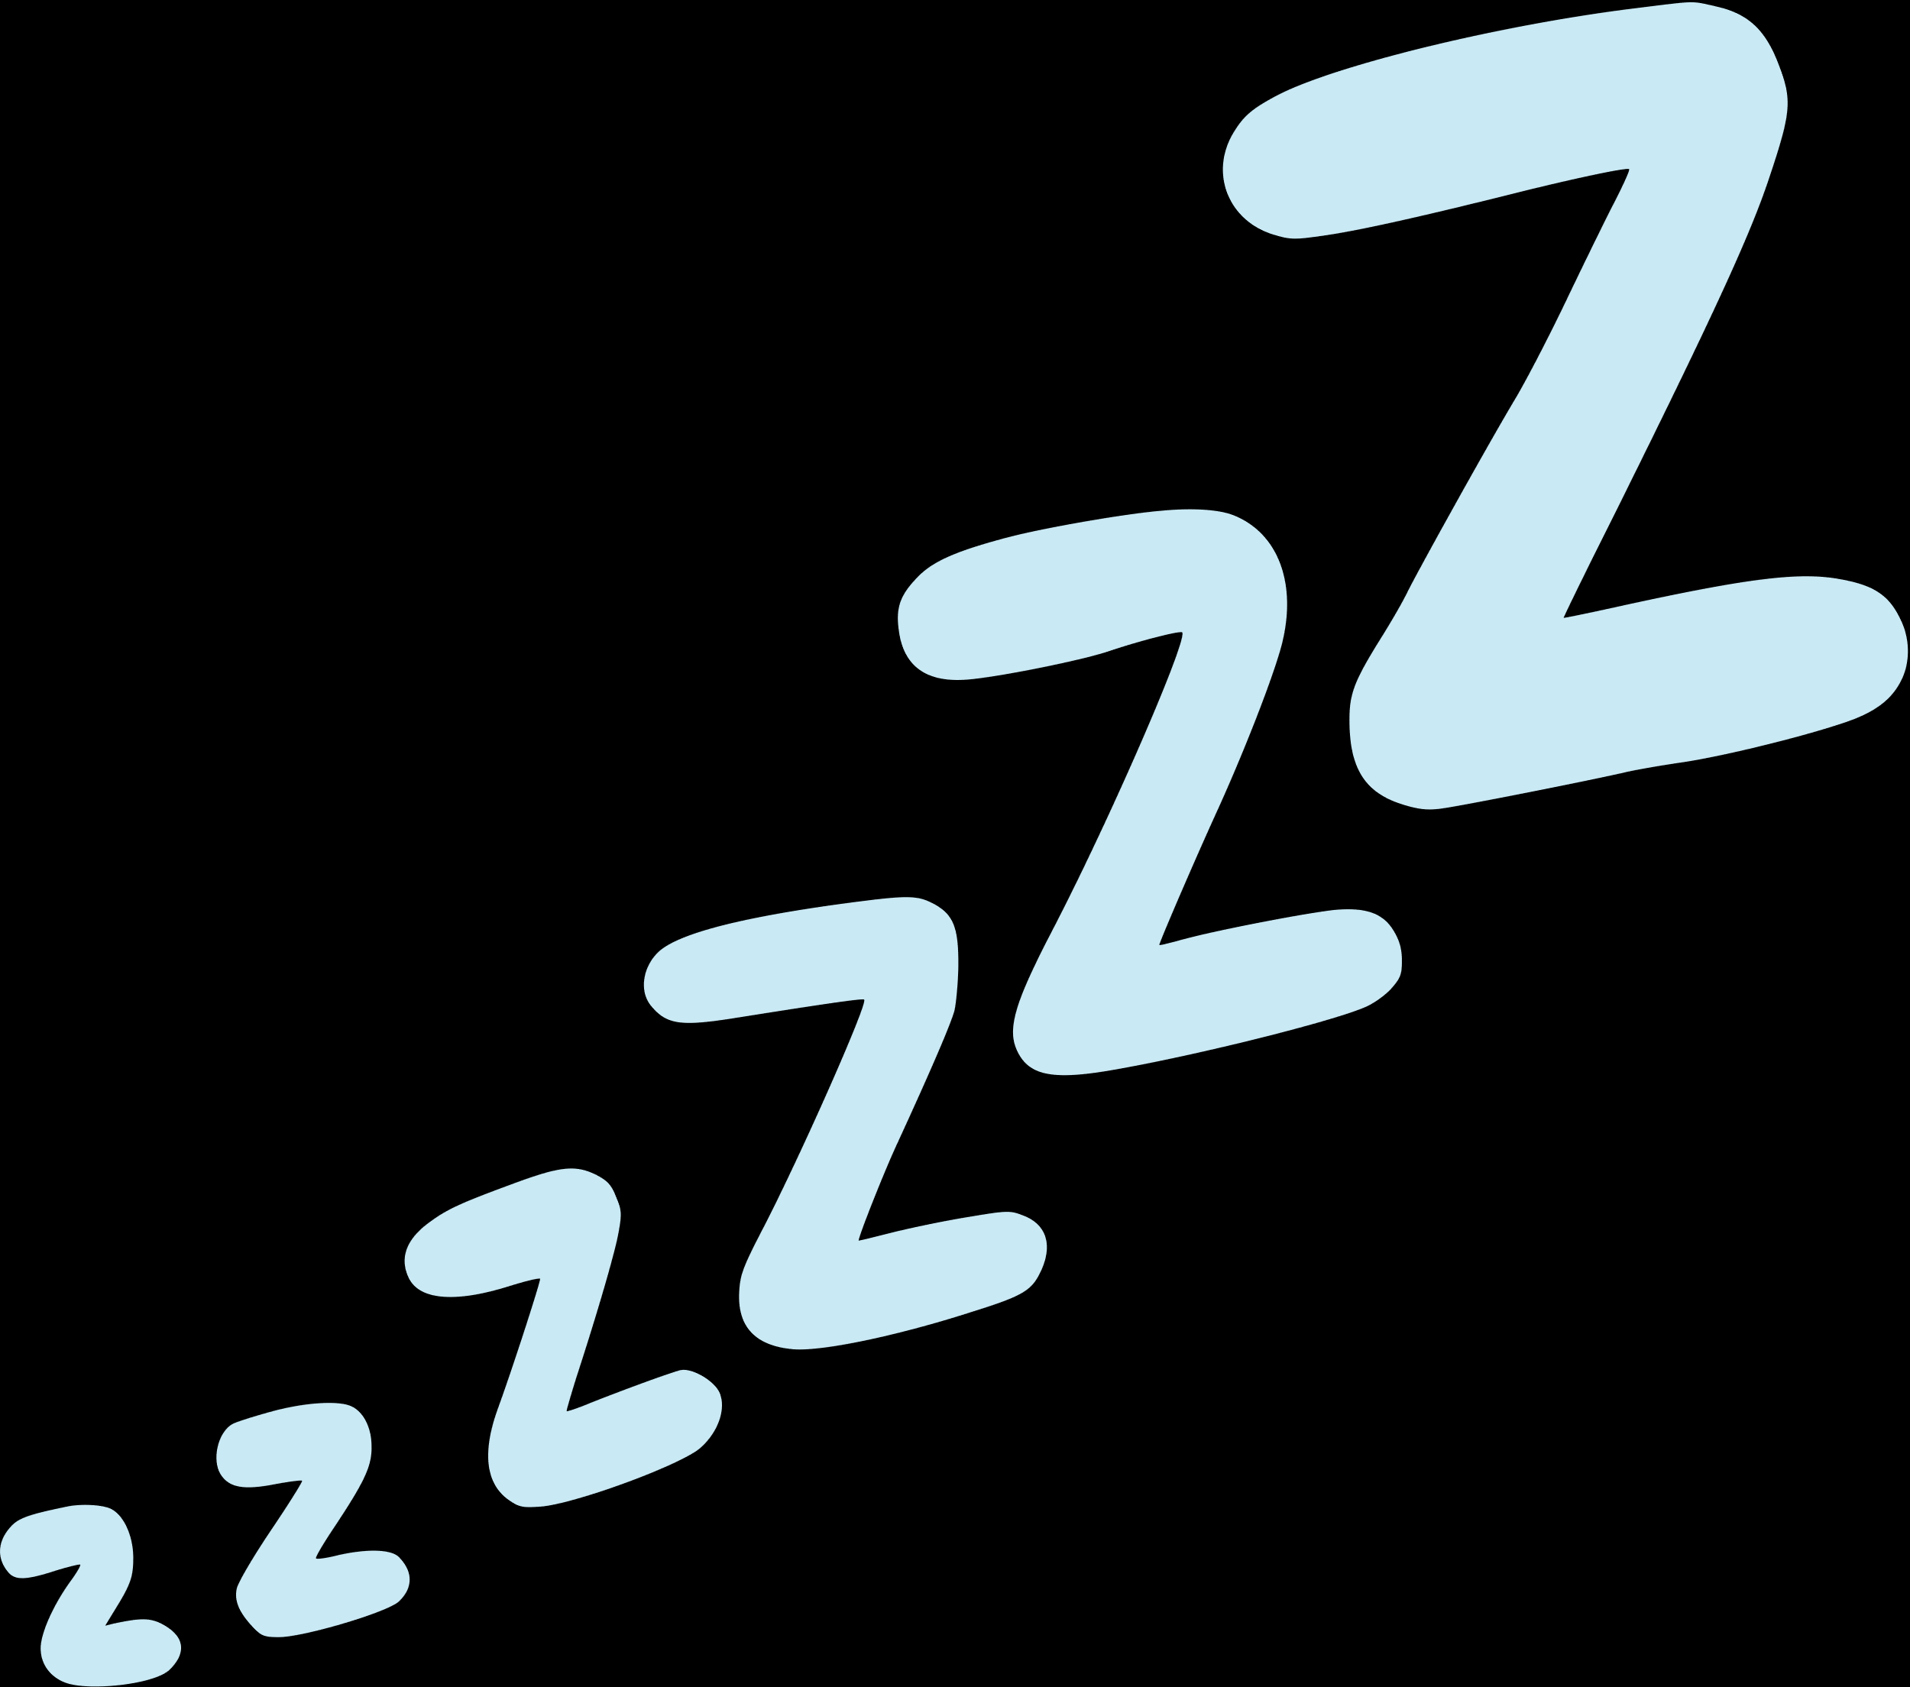
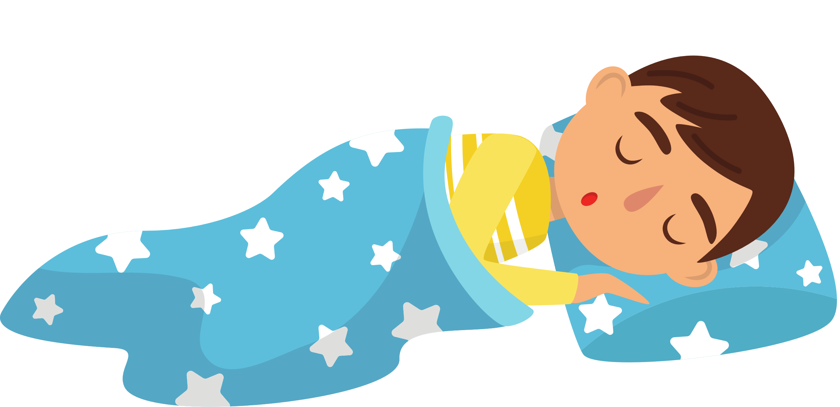

Why We Need Sleep
Sleep is the time when our body and brain rest and recover from the activities of the day.
When we sleep:
we grow,
we heal,
we learn,
…and we feel good.
Sleep helps us to be healthy, happy, and smart.
Notes:
Sleep is the time when our body and brain rest and recover from the activities of the day. When we sleep: we grow, we heal, we learn, and we feel good. Sleep helps us to be healthy, happy, and smart.

Slide 10





What the Scientists say about sleep
Energy
Healing
Brain
Notes:
Let’s take a listen to what Scientists have to say about sleep!
The video is embedded on the following slide.
Have you noticed that when you get movement throughout the day, it’s easier to rest and sleep at night? In our next activity, we will work in some movement that challenges the coordination in our brain, and then try a relaxation exercise.

Slide 11

Energy
Healing
Brin
Notes:
Let’s take a listen to what Scientists have to say about sleep!
Have you noticed that when you get movement throughout the day, it’s easier to rest and sleep at night? In our next activity, we will work in some movement that challenges the coordination in our brain, and then try a relaxation exercise.

Slide 12

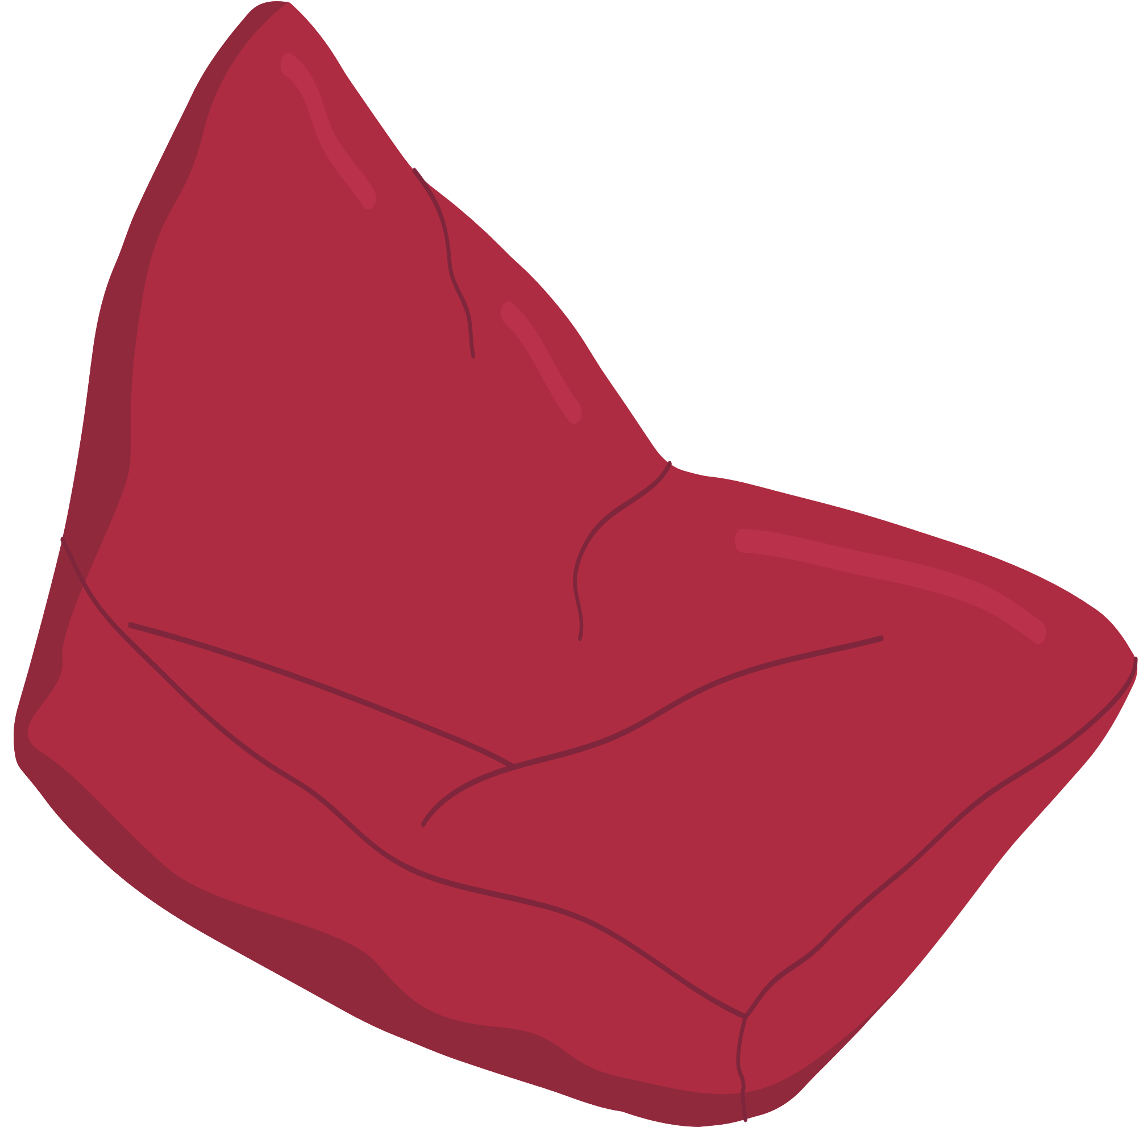
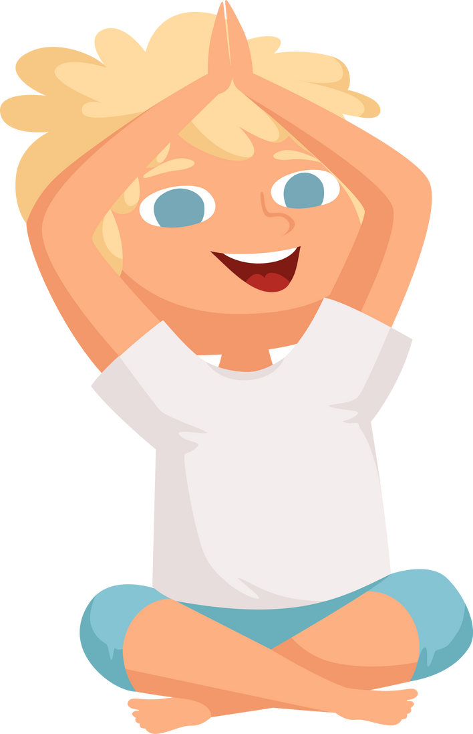


Bean Bag Challenges
Movement Break!
Notes:
Now that we know moving our bodies during the day help us have better sleeps, let’s move.
Note: Have one student pass out beanbags to each student.
Teacher Tip: Review expectations of how students behave with bean bags in the classroom.
1. Use your body not your mouth.
2. The bean bag is not to be thrown high or at someone else
3. When I say “Freeze” you stop and put beanbag on your head and stand on one leg.
4. This is a privilege to play with beanbags in your class. Let’s not ruin it for everyone. Do what is expected of you
Note: Challenges are listed on the next slide.

Slide 13
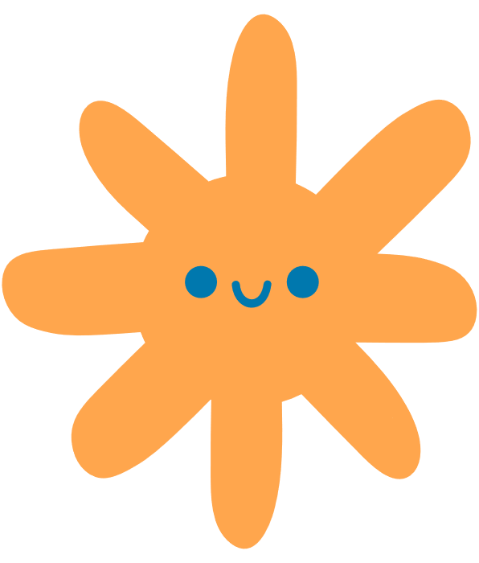

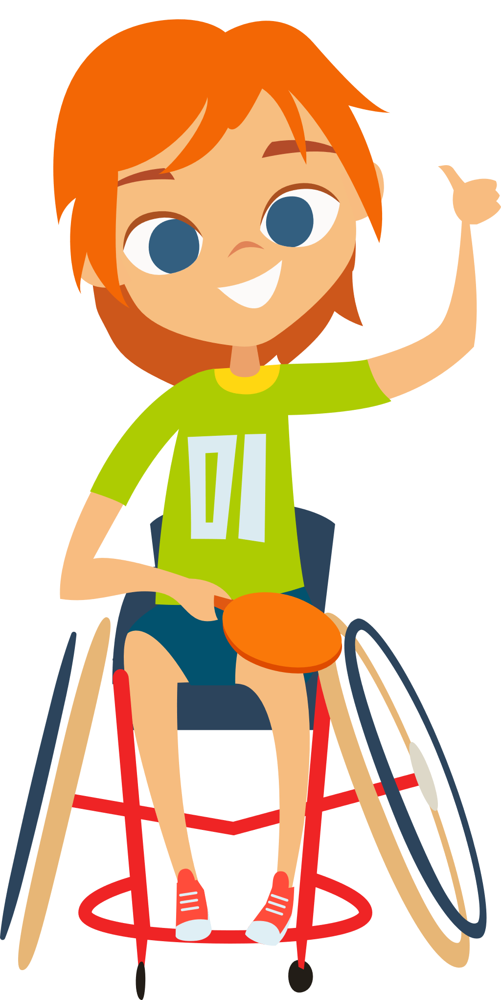

Try these out:
  Bean Bag Balance
  (bean bag on top of head)
  Go/Go Stop
  Bean Bag Toss from hand to hand
  Bean Bag toss in one hand and the other hand behind your back
Extra challenge:
  On your back
  In between your toes
  (while sitting on the floor with legs out)
  In between your knees
  (while sitting on the floor with legs out)
Notes:
Note: Challenge the students to try the following challenges. Have one or two students demonstrate.
Bean Bag Balance (bean bag on top of head) - Go/Go Stop
Bean Bag Toss from hand to hand
Bean Bag toss in one hand and the other hand behind your back?
Tricky catches:
On your back
In between your toes (while sitting on the floor with legs out)
In between your knees (while sitting on the floor with legs out)
Have the teacher collect the bean bags for you.

Slide 14


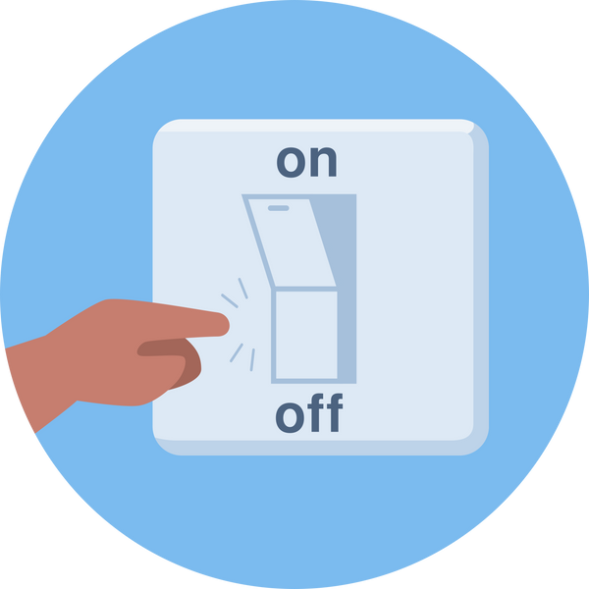



How can we make sure we get a good night’s sleep?
Have a regular bedtime routine
Keep your bedroom dark, quiet and cool
Move during the day
Power down screens 1-2 hours before bed
Limit food and drinks that boosts energy before bed
Notes:
How can we make sure that we get a good night’s sleep?
Note: Toss a soft ball, or soft toy to each child that has their hand up. Once they catch the ball/toy, they can share their idea. Round out the discussion by reviewing some of the tips below:
Have a regular bedtime routine. This means doing the same things every night before you go to bed, such as brushing your teeth, reading a book, or listening to a story. This helps your body and mind to relax and get ready for sleep.
Power down screens 1-2 hours before bed. This means saying goodnight to the TV, computer, tablet, or phone one to two hours before you sleep. Screens can make your brain too alert and making it hard to fall asleep.
Keep your bedroom dark, quiet, and cool. This helps your body to produce a signal hormone called melatonin, which makes you sleeping and tells our brain it’s time to rest. You can use curtains, blinds, or shades to block out the light. You can also adjust the temperature of your room (windows if no temperature gauge), your blanket or the clothes you wear to sleep to make it comfortable for you.
Limit high energy food and drink before bed. Some foods and drink can make you too energetic and prevent you from falling asleep or staying asleep. (Note: caffeinated beverages and food like pop, coffee, tea, energy drinks & chocolate within 4-6 hours of bedtime can make it hard for children to wind down for a good night’s sleep).
Move during the day. This means being active and playing outside, or doing sports, dance, or yoga. We learned how moving often can help you to use up your energy, improve your mood, and make you tired enough to sleep well at night. Health professionals suggest 30 minutes of moderate to vigorous activity every day - this means getting your heart rate up, when you’re “huffing and puffing” and you cannot sing a song while moving.
*Note for parents: PA late at night can affect sleep. Conversation with teachers/schools: not to shame if students are coming in later when they're engaging in extracurricular activities with early morning or late practices.

Slide 15
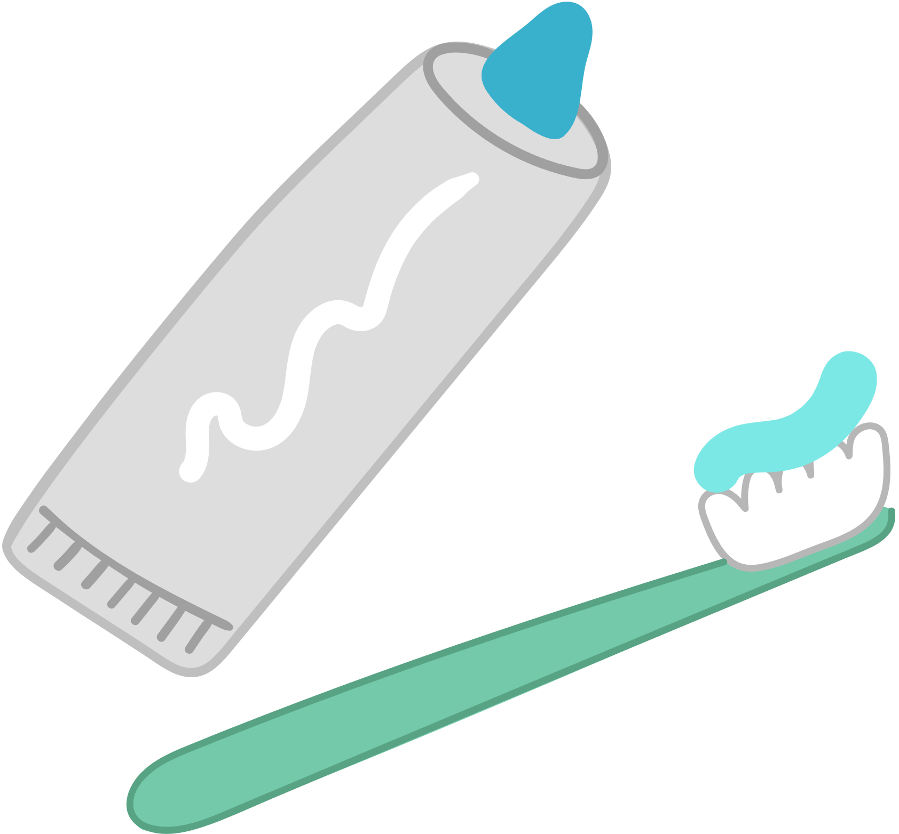


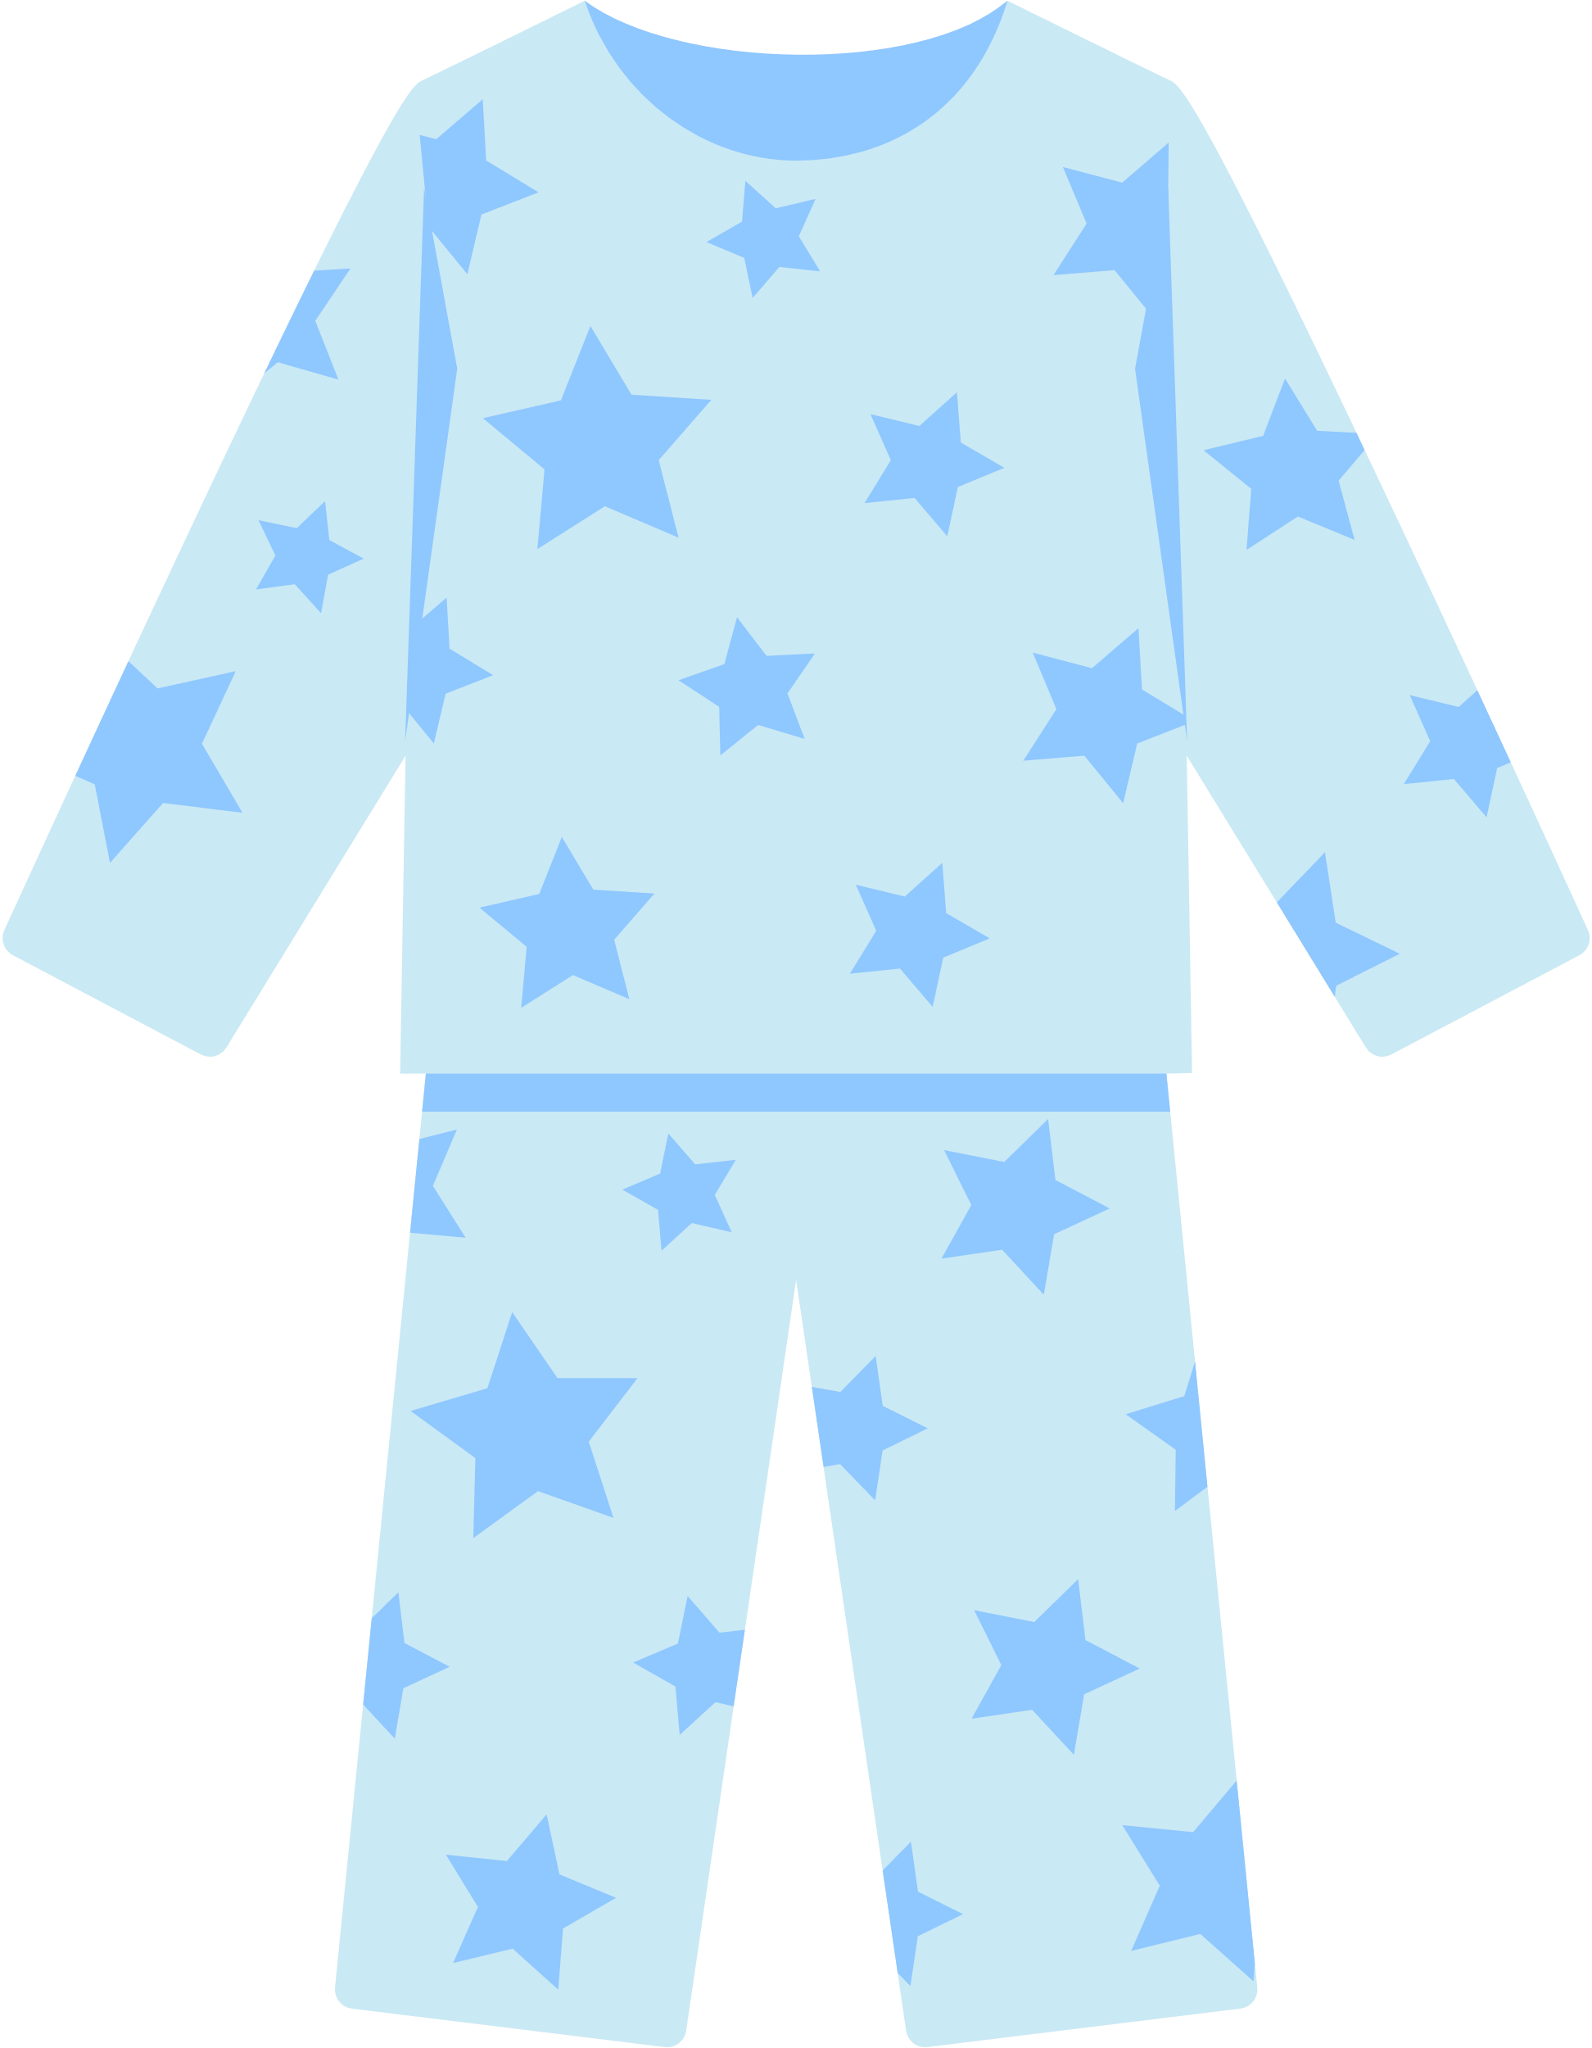

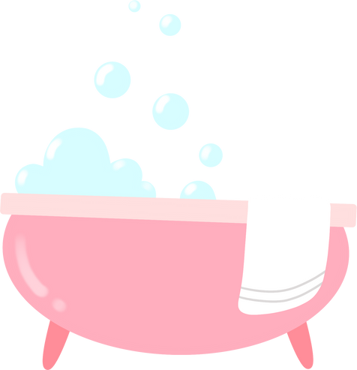

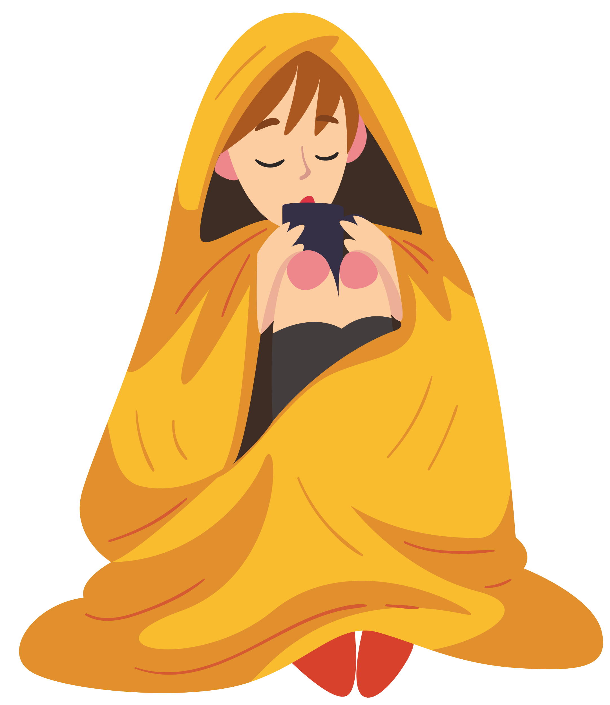
What can you include in your bedtime routine?
Put on Pajamas
Clean Up
Brush Teeth
Use Toilet
Snuggle & Sleep
Take Bath
Read Books
Notes:
Here’s some examples of what you could include in your bed time routine.
Note: This is another opportunity to foster familial / household connections. Each household is different – some may include grandparents, or aunts and uncles – consider how to be inclusive and encourage a bedtime routine that fosters rituals within the household that strengthens emotional connection. You can also ask if there are any cultural or traditional routines that students might have , or encourage them to take these learnings home and explore this topic further.

Slide 16
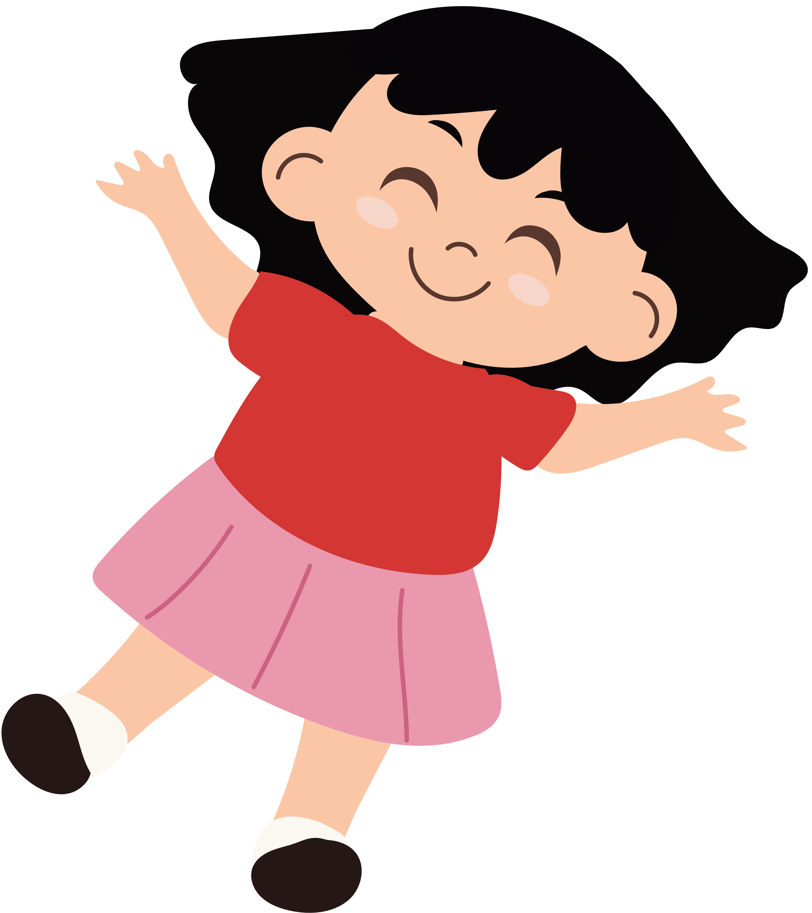
Do Nothing Doll
Rest Break!
Notes:
Instructions:
Have students spread out to find their own space on the floor.
Instruct each student to lay down with their back to the floor, legs straight and palms facing the ceiling. Students can close their eyes if they feel comfortable.
Invite the students to focus on slowing down their breathing and calming their bodies. While they are laying quietly, speak gently and review some of the key points we have covered in the four modules (a review is on next slide as well)
Once they can demonstrate that their body and mind is calm, the PHN or teacher can tap them on their toe.
Once their toe has been tapped, the student can silently return to their desk.
Note: Remind them about the importance of being able to do nothing - note who continues to wiggle

Slide 17
WHAT HAVE WE LEARNED
SO FAR?
Notes:
Let’s reflect on everything we’ve learned over the past four lessons:
Note: Review this content as the students are laying down in ‘do nothing doll.’ They can reflect on what they’ve learned and listen to your voice as they relax.
Moving our bodies is fun, can help us stay healthy, and is a great way to connect to our friends and family, as well as boost our mood
Physical literacy gives us the competence, confidence, and motivation to be active for life, and gives us the skills we need to move our body in every way we want
Food and water are essential fuels for our body. Food is a great way to connect to culture and friends and family. We can learn to listen to our body’s signals so that we can give it what it needs: whether it’s hungry, tired, thirsty, or needs movement or social connection.
Rest is an essential part of physical health. Sleeping allows us to grow, heal, learn, and feel good. Sleep helps us to be healthy, happy, and smart.
We can make sure we get enough sleep by moving our bodies throughout the day, turning off screens a few hours before bedtime, and having a good bedtime routine.

Slide 18

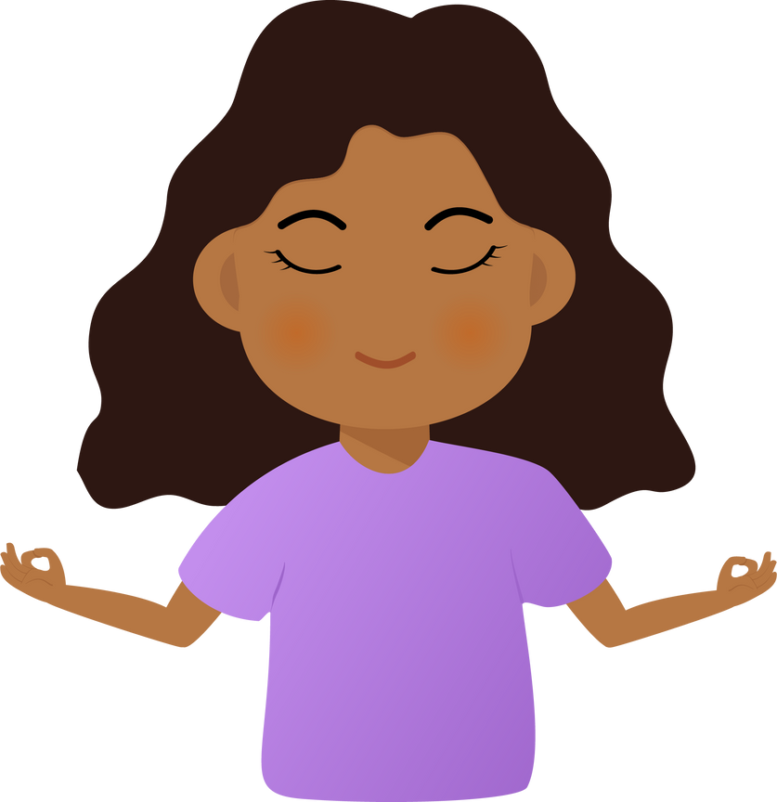
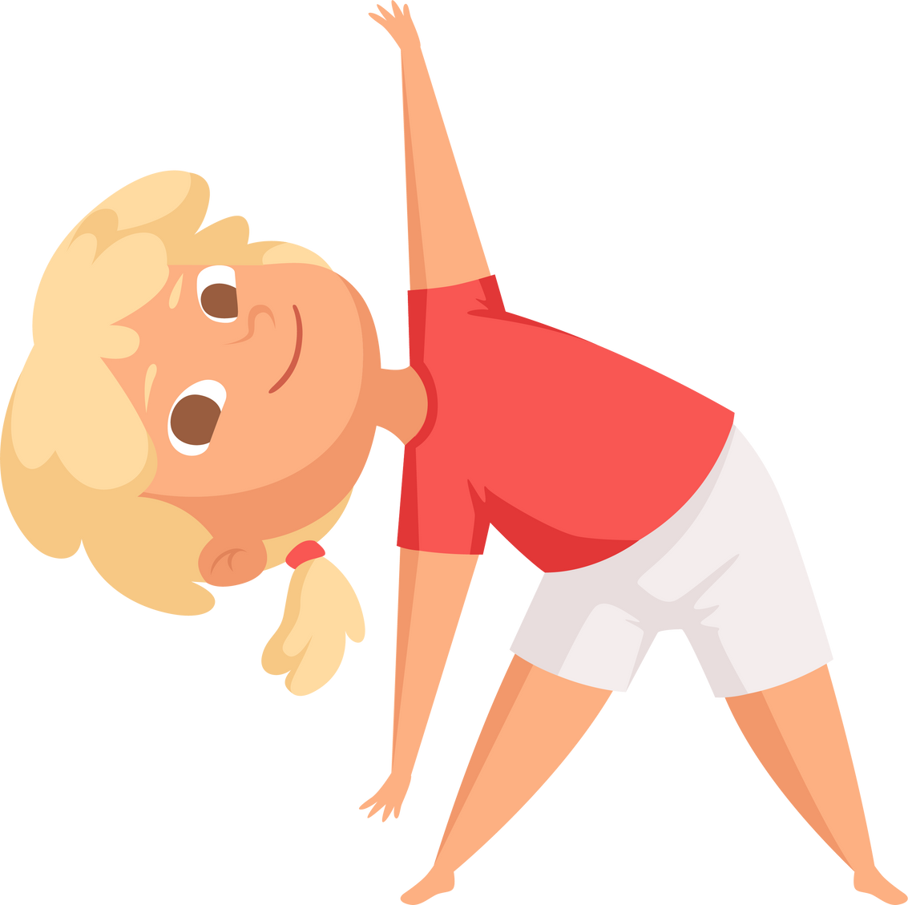
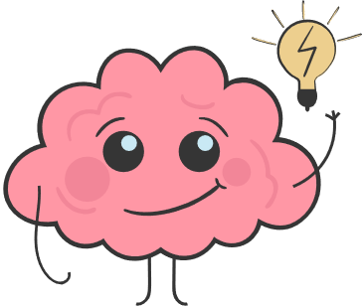
Movement Food and Rest Makes...
Our bodies
  healthier
  Our brains learn better
Our bodies
  calmer and happier
Notes:
Notes: Have students say this message with you.
Movement makes:
Our bodies healthier!
Our brains better learners!
Our bodies calmer and happier!
Note: Thank the class for their engagement and sharing. Let them know that their teacher may continue to bring some of the fun activities into their classrooms.
The module manual accompanying these lecture slides can be left with the teacher as a reminder of the key concepts and as a tool to confidently bring these lessons into their classroom. Follow up with the teacher on sending them any lesson plans or supportive material.

Slide 19








Thank you to our contributors!

